Slide 1
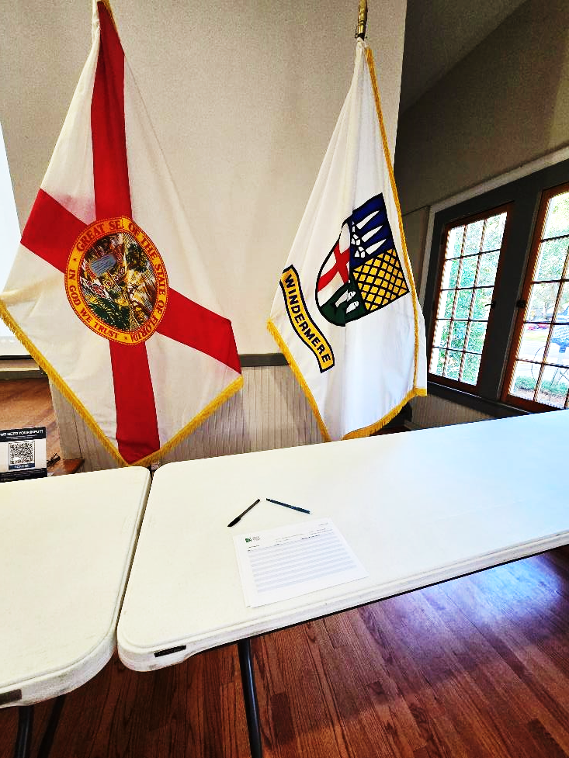
Town of Windermere Town Square Charrette
October 30, 2024
Please Sign in

Slide 2
Town of Windermere Town Square Charrette
October 30, 2024

Slide 3
Introduction (10 Minutes)
Design Team Presentation (15 Minutes)
The Main Event Charrette Breakout Session (50 Minutes)
Concept Prioritization (10 Minutes)
Closing (15-30 Minutes)

Slide 4
Introduction

Slide 5
Goals and Scope of the Project
Analyze the existing conditions and uses of Town Square
Facilitate an open discussion for future Planning Efforts
Present Input to Town Council at a Workshop
Prepare several concepts based on the Stakeholder Input
Present Concepts to Town Council

Slide 6
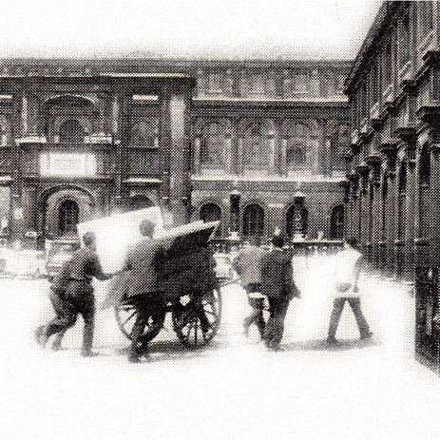
Expectations and Purpose
What is a Design Charrette?
Charrette, a French word meaning “chariot” or “cart,” derives from stories of architectural students during the Beaux-Arts Period in Paris during the 19th century. The students’ work was collected in a charrette, and many continued frantically sketching as their designs were collected for critique.
A design charrette is an assembly of stakeholders who work together in a condensed session to strive towards a common design solution. Ideas are explored through collaboration via both writing and sketched concepts to discover and further diverse design ideas.

Slide 7
Design Team Presentation

Slide 8
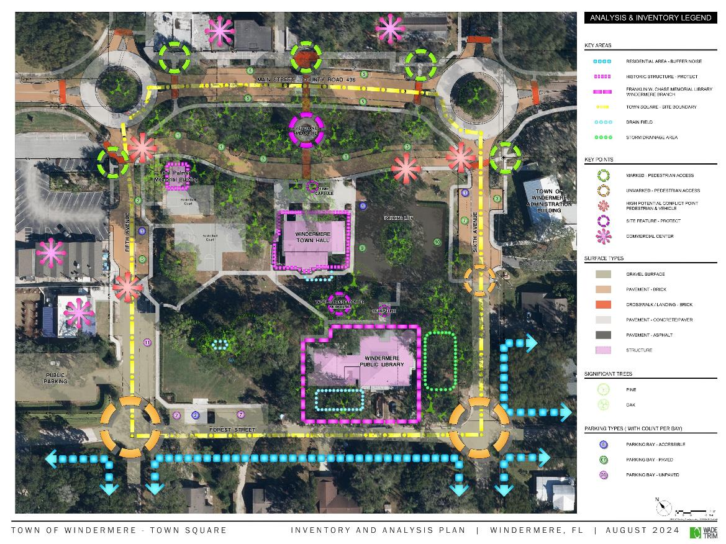
What we know
Site Analysis
Current Uses
Planned Improvements

Slide 9
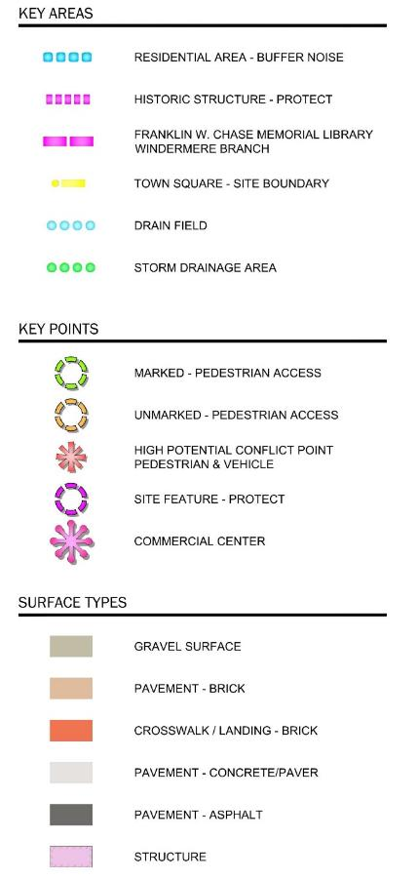
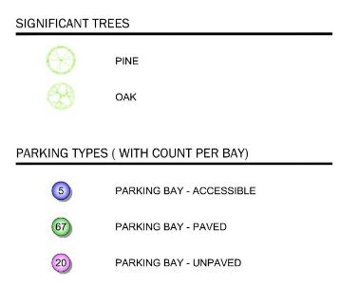
Site Analysis
Notes:
Present info from Site Analysis

Slide 10
Current Uses
Friday Farmers Market
Fourth Friday Food Trucks
Wine and Dine
Run Among the Lakes
Halloween Holiday Hoopla
Art Fair
Centennial Events
PetFest
Back to School Celebration
Notes:
Not all inclusive.

Slide 11
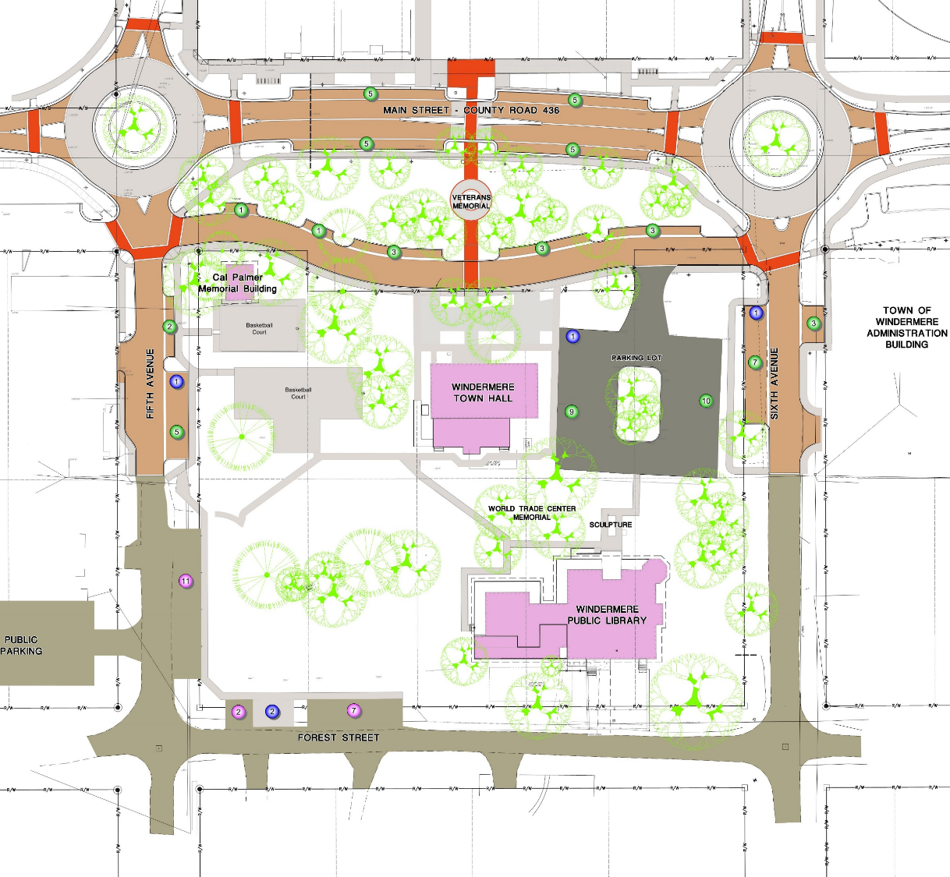
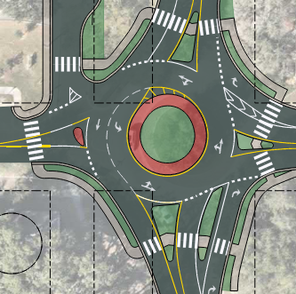
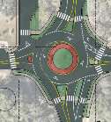
Planned Improvements
Parking Access from 6th Ave
6th Ave Roundabout Improvements

Slide 12
The Main Event Breakout Session

Slide 13
Ground Rules
You are part of a group at your table
Each group must select a scribe/facilitator
No Idea is a bad idea
Allow everyone an opportunity to voice their thoughts
Notes:
The scribe and facilitator may be the same person or two different people.

Slide 14
Small Group Icebreaker (5 Minutes)
Introduce yourself to the group, then get to know the members of your group by each answering the question…
What is your most memorable activity or event in the Town of Windermere?

Slide 15
Small Group Discussion (5 Minutes)
What is your favorite part about Town Square as it is currently?
What is your least favorite part about Town Square as it is currently?

Slide 16
Small Group Discussion
Finalize your group’s thoughts.
Please decide on
one Favorite Part of Town Square
&
one Least Favorite Part of Town Square
within your group.

Slide 17
Small Group Presentation (5 Minutes)
Our Group’s favorite parts about Town Square is _________.
Our Group’s least favorite parts about Town Square is _________.
Notes:
Chris & Sarah write favorites and least favorites

Slide 18
What do you want?
Notes:
Mention big picture items or details from imagery

Slide 19
What do you want?
Notes:
Mention big picture items or details from imagery

Slide 20
What do you want?
Notes:
Mention big picture items or details from imagery

Slide 21
What do you want?
Notes:
Mention big picture items or details from imagery

Slide 22
What do you want?
Notes:
Mention big picture items or details from imagery

Slide 23
What do you want?

Slide 24
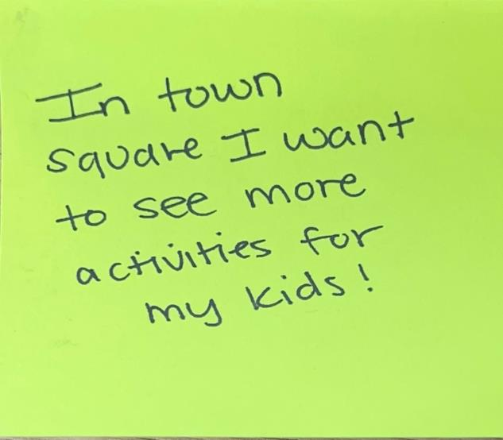
What do you want?
Notes:
Our idea imagery is just a catalyst, not an exhaustive list to select from. Residents are welcomed to add their ideas.

Slide 25
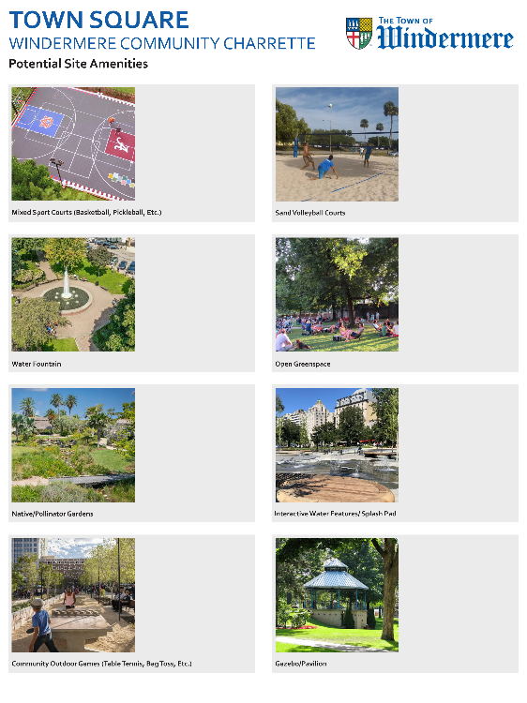
What do you want? (10 Minutes)
Review the ideas presented around the room.
Prioritize your likes and dislikes with adhesive dots.
LIKE
DISLIKE
Notes:
Hand out 3 Orange and 2 Blue dots for idea polling. Everyone up and review the idea boards and place polling dots on your personal likes and dislikes. Move to next slide while polling takes place.

Slide 26
What do you want? (15 Minutes)
Expand by showing potential locations for elements you want to see on Town Square by sketching and/or using sticky notes to place the elements on the plan.
Story Walk
Green Lawn
Parking Area
Community
Garden
Notes:
Hand out markers and plans

Slide 27
Small Group Presentations (10 Minutes)

Slide 28
Concept Prioritization

Slide 29
Concept Priority (10 Minutes)
Review the concepts presented around the room.
Prioritize the Overall Plan you find most favorable with green adhesive dots.
Story Walk
Green Lawn
LIKE
Parking Area
Community
Garden

Slide 30
Closing

Slide 31
Closing
Thank you for attending the Windermere Town Square Design Charrette!
Want to provide additional input and feedback? Take the ONLINE SURVEY!

