Slide 1
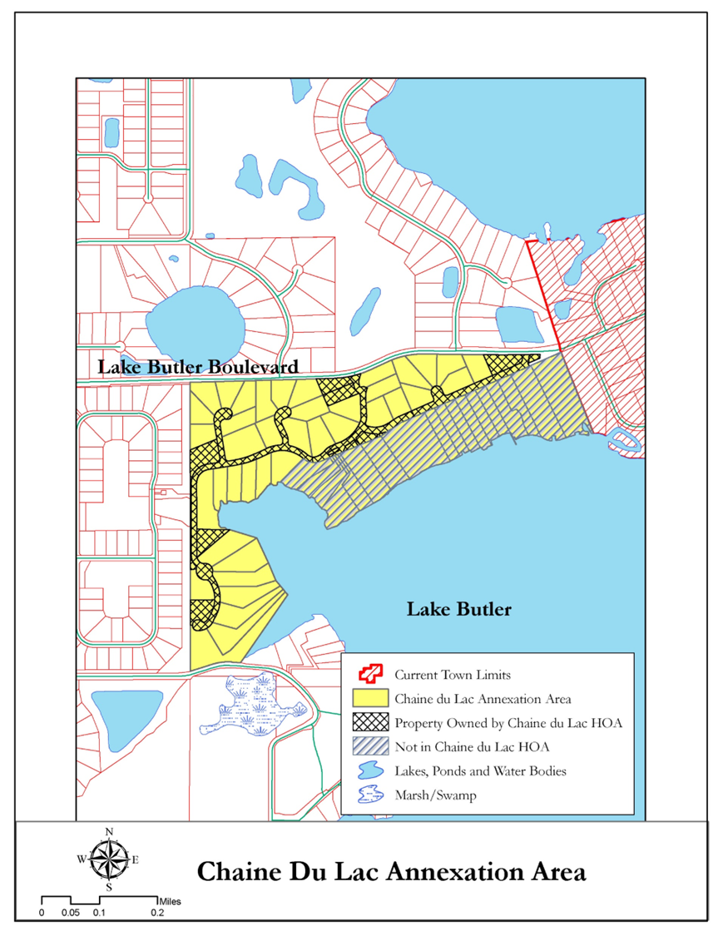
Chaine Du Lac Annexation Public Meeting
July 2023

Slide 2
Proposed Chaine Du Lac Annexation Area
South of Lake Butler Blvd. (West of Town Limits)
103 Acres
74 Parcels
51 Single-Family Dwelling Units
County Future Land Use: Rural Settlement (RS 1/1)
County Zoning: Rural - Country Estate - Cluster (R-CE-C)
Source: Orange County Property Appraiser, July 18, 2023

Slide 3
Annexation Process
Voluntary Annexation: A property owner with land adjacent to the Town requests to become part of the Town. If the Town agrees, the Town passes an ordinance for the voluntary annexation and the property is annexed.
Involuntary Annexation: The Town identifies land next to the Town limits for potential annexation and enters a three-step process:
Town studies the land and develops a plan for providing public services and analyzes financial impact.
Town notifies Orange County of potential annexation.
Town holds public hearings and Town Council approves ordinance regarding potential annexation.
Town holds a referendum that allows registered voters to vote on the proposal to annex.
Town adopts amendment to its Comprehensive Plan and Zoning Map to include the annexed area.

Slide 4
Annexation Process
Town will ask for a petition signed by at least 51% of the property owners (1 per property) that states their support for the Chaine Du Lac annexation.
Annexation process will be involuntary and requires the approval of a referendum (vote) by the registered voters within the Chaine Du Lac area proposed for annexation.
Town has option, but not required, to also have the registered voters within the Town approve the annexation by referendum.

Slide 5
Statutory Standards
Chapter 171, Florida Statutes (F. S.) provides specific criteria regarding annexation.
To qualify for annexation:
“The total area to be annexed must be contiguous to the municipality’s boundaries at the time the annexation proceeding is begun and reasonable compact, and no part of the area shall be included within the boundary of another incorporated municipality.” (Sec. 171.043 (1), F. S.)
Chaine Du Lac is contiguous with the western Town limit south of Lake Butler Blvd.
Chaine Du Lac is compact and does not create any enclaves, pockets, or finger areas in serpentine patterns.
Chaine Du Lac annexation area is compliant with Section 171.043(1), F.S.

Slide 6
Statutory Standards (Cont’d)
To qualify for annexation:
“It is so developed that at least 60 percent of the total number of lots and tracts in the area at the time of annexation are used for urban purposes, and it is subdivided into lots and tracts so that at least 60 percent of the total acreage, not counting the acreage used at the time of annexation for nonresidential urban purposes, consists of lots and tracts 5 acres or less in size.” (Sec. 171.043(2)(c), F. S.)
Urban purpose is defined as:
“Land [that] is used intensively for residential, commercial, industrial, institutional, and governmental purposes, including any parcels of land retained in their natural state or kept free of development as dedicated greenbelt.” (Sec. 171.031(10), F. S.)
100% of the total number of lots and tracts within Chaine Du Lac are used for urban purposes (based on OCPA data).
100% of the residential lots and tracts within Chaine Du Lac are 5 acres or less in size
Chaine Du Lac annexation area is compliant with Section 171.043(2)(c), F.S.

Slide 7
Development Regulations
Orange County’s Land Development Code regulations remain in effect until Town’s Comprehensive Plan is amended to include the Chaine du Lac area.
Once Town’s Comprehensive Plan is amended, Town’s Land Development Code regulations take effect.
Town’s Land Development Code allows for continuance of prior approved Orange County development agreements (Chaine du Lac and Park Avenue West) for annexed subdivisions to stay in effect after annexation.
Town will assign the Planned Unit Development (PUD) Future Land Use and Zoning with specific development standards as part of the PUD to address conflicts with Orange County zoning requirements and Town zoning requirements.

Slide 8
Potential Timeline for Annexation
After receipt of petition from at least 51% of property owners supporting the annexation (assumes special election by mail ballot):
30 days to complete annexation analysis
60 days for required public hearings for approval of ordinance for annexation
30 days for referendum (after referendum scheduled)

Slide 9
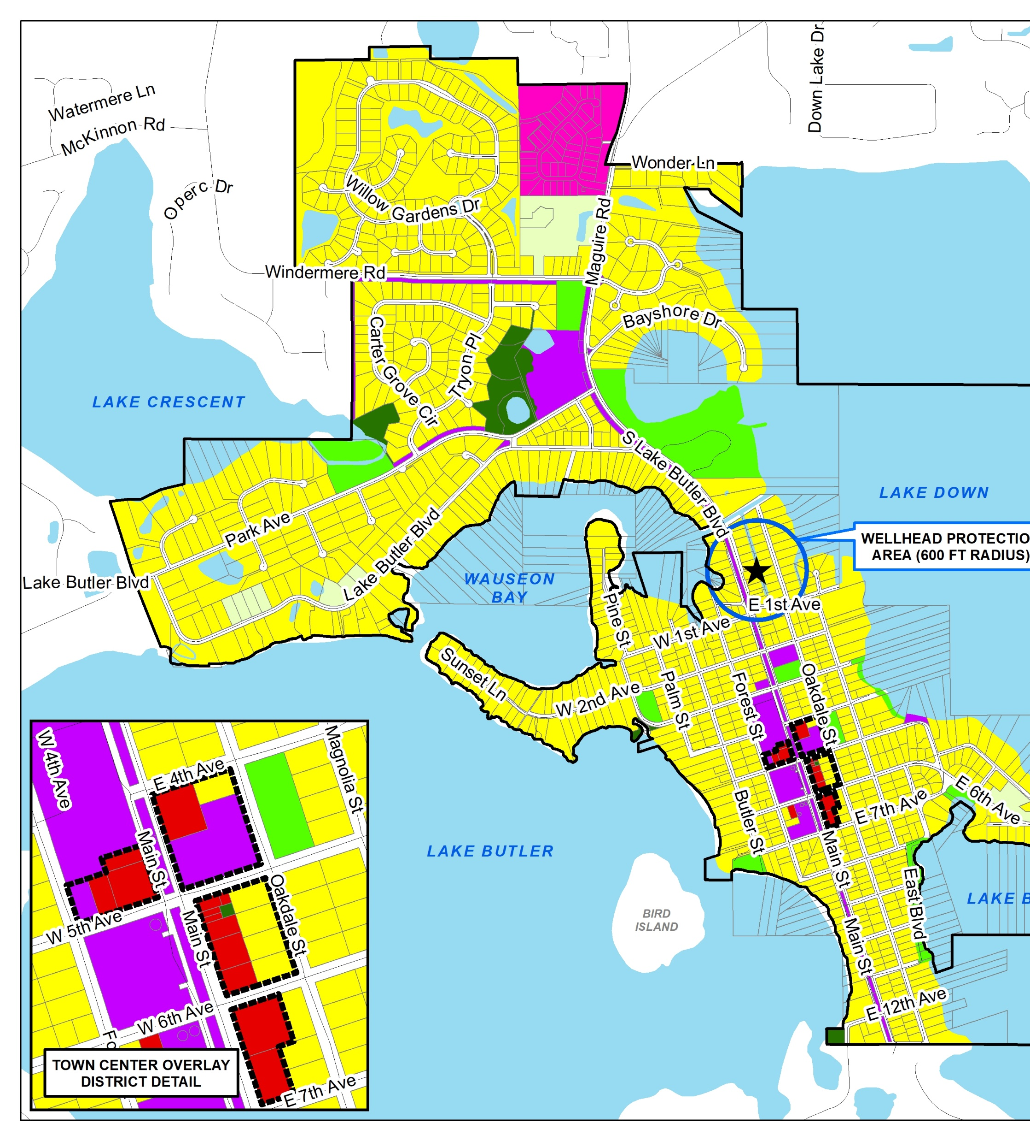
Potential Timeline for Annexation
If referendum for annexation is approved:
60-90 days to process required Comprehensive Plan amendment and Rezoning to assign Town designations.

Slide 10
ADMINSITRATIVE ISSUES
Town Responsibilities vs. HOA responsibilities
Solid Waste/Recycling
Fire Service Protection & EMS
Politics
Additional Benefits
Financial Impacts

Slide 11
TOWN RESPONIBILITIES vs. HOA RESPONSIBILITIES
The Town would accept the existing agreement (Plat) entered into with Orange County.
HOA would continue to be responsible for the roads, common areas, stormwater and lighting.
The Town would memorialize this in an Annexation Agreement

Slide 12
SOLID WASTE/RECYCLING
Once Annexation is completed, the Town would take over solid waste and recycling for the development. The Town’s current contracted waste service and recycling provider is Waste Pro.
The Town operates 2x a week solid waste pick up (Tuesday and Friday)
The Town operates recycling pick up 1x a week (Tuesday)
The Town operates yard waste pick up 1x a week (Wednesday)
Solid Waste: 19.68/Month $236.16/Year Recycling: $6.39/Month $76.68/Year
You are currently paying $260 for 1x a week pick up.

Slide 13
FIRE SERVICE PROTECTION/EMS
The Town of Windermere does not have a Fire Department. The Town has a continuing services contract with Ocoee Fire Department. Ocoee will provide Fire and EMS services. The Town pays for this through a tax assessment.
The assessment is calculated currently at .8 mills but will more than likely be reduced next fiscal year to .7 mills.
Ocoee and Orange County have an automatic aide agreement. Ocoee covers the calls for Orange County in the norther area where Ocoee has more stations and Orange County covers calls in the southern area for Ocoee where Orange County has more stations.

Slide 14
POLITICS
Once annexed into the Town, the residents of Chaine Du Lac would be able to vote in Town of Windermere elections. This will provide more of a local say in what directly impacts this area. After a year of residency the residents would also be eligible to run in Town of Windermere elections.
Residents will continue to be Orange County residents and would still vote for Orange County Mayor, Sheriff, etc.
More direct access to local leaders and staff.

Slide 15
Added Benefits
Once Annexed, residents of Chaine Du Lac will be able to access the Towns Boat Ramps and Tennis Courts.
Boat Ramps: Fernwood (Butler) and Bessie
Tennis Courts: Main St. and Windermere Recreation Center
Residents would be eligible to attend resident only events.
Residents receive a discount on Town Hall Rentals
Residents can sit on one of the various Town’s Boards or Committees that provide recommendations to the Town Council on various subject matters. (DRB, HPB, Tree, LRP, WAYS,P&R)
Disaster Recovery. The Town was one of the first to complete the disaster recovery from Hurricanes Irma and Ian. The reason is a more local focus than County wide.

Slide 16
Financial Impact
With the current millage rate of 3.7425, Solid Waste, Fire Rescue and Windermere Stormwater assessments, the Chaine Du Lac Residence would see a cost difference of @ $375/Year.
If the Town Council reduces the cost of the Fire Assessment for next Fiscal Year, that costs difference could range between $150-$275/Year.

Slide 17
WINDERMERE POLICE DEPARTMENT
Accredited Agency
New facilities / shareable community training room
100% staffing
Level of service / Direct access
Regional assets

Slide 18
QUESTIONS?

