Slide 1
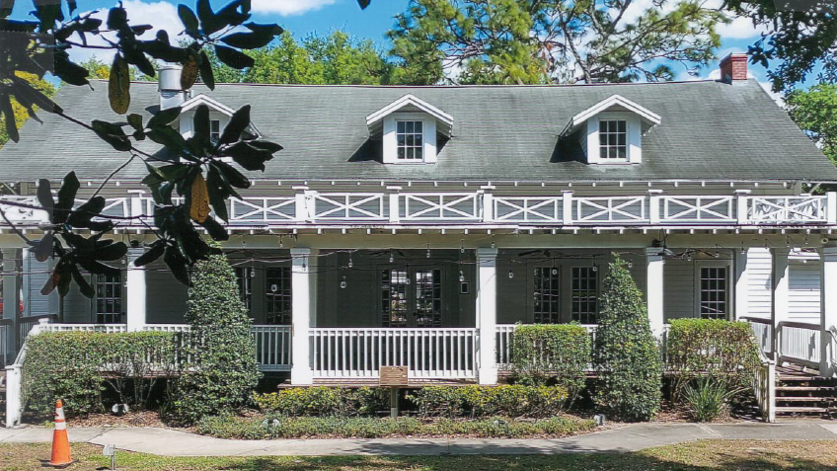
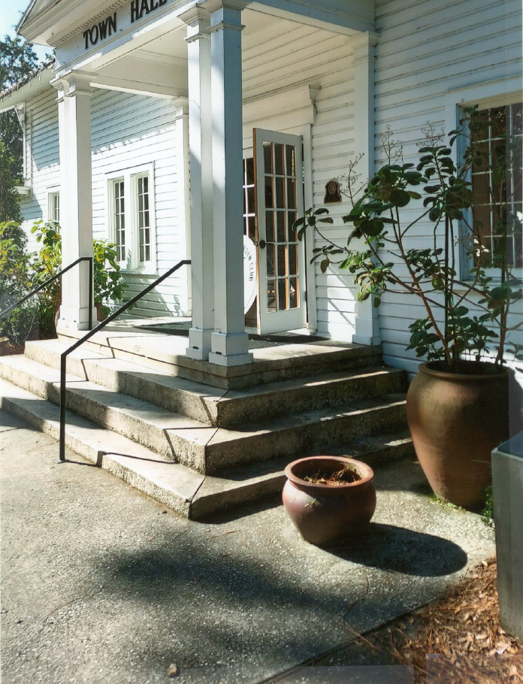
Windermere
Town Hall Renovations

Slide 2
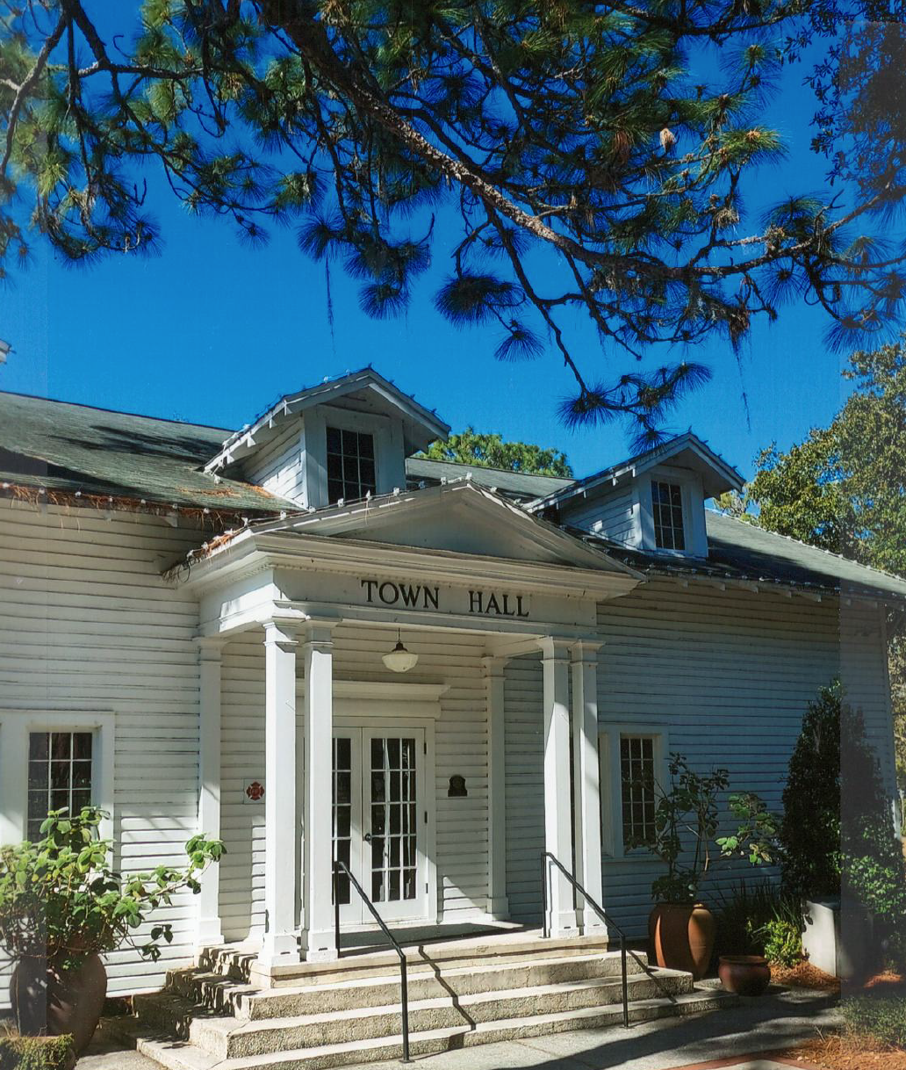
Proposed Enhancements and Modifications
Safety, Accessibility and Functionality
Provide foundation enhancements for porch columns
Provide new handicapped ramp on north side
Improve stage access and add HC lift for accessibility
Add new exits at west stage area and back Kitchen east side
Add guard rails at main entry landing
Remove steps at NE corner of TH
Provide access from multipurpose room to porch
Historical Aesthetic Improvements
Improved roof enhancements
Renovate porch columns/stairs/rails with Hardie board
Replace rotted wood
New metal roof for entire facility
Eliminate flat roofs over Porch and Toilet extensions
with pitched ‘overbuild’ metal roofs, to gutters
Additional Enhancements
Multi-purpose room serves also as Bridal Room
when engaged with adjacent Family Toilet
Restroom Expansion
Addition of two Family/Accessible Restrooms
Exterior Access to TH Restrooms
New Kitchen Equipment and Serving Counter with
wall cabinets between windows.

Slide 3
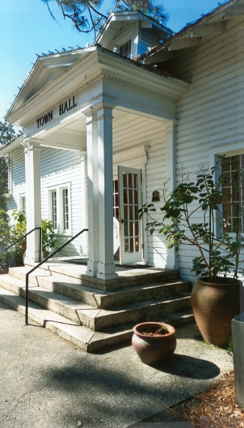
Existing Floor Plan

Slide 4
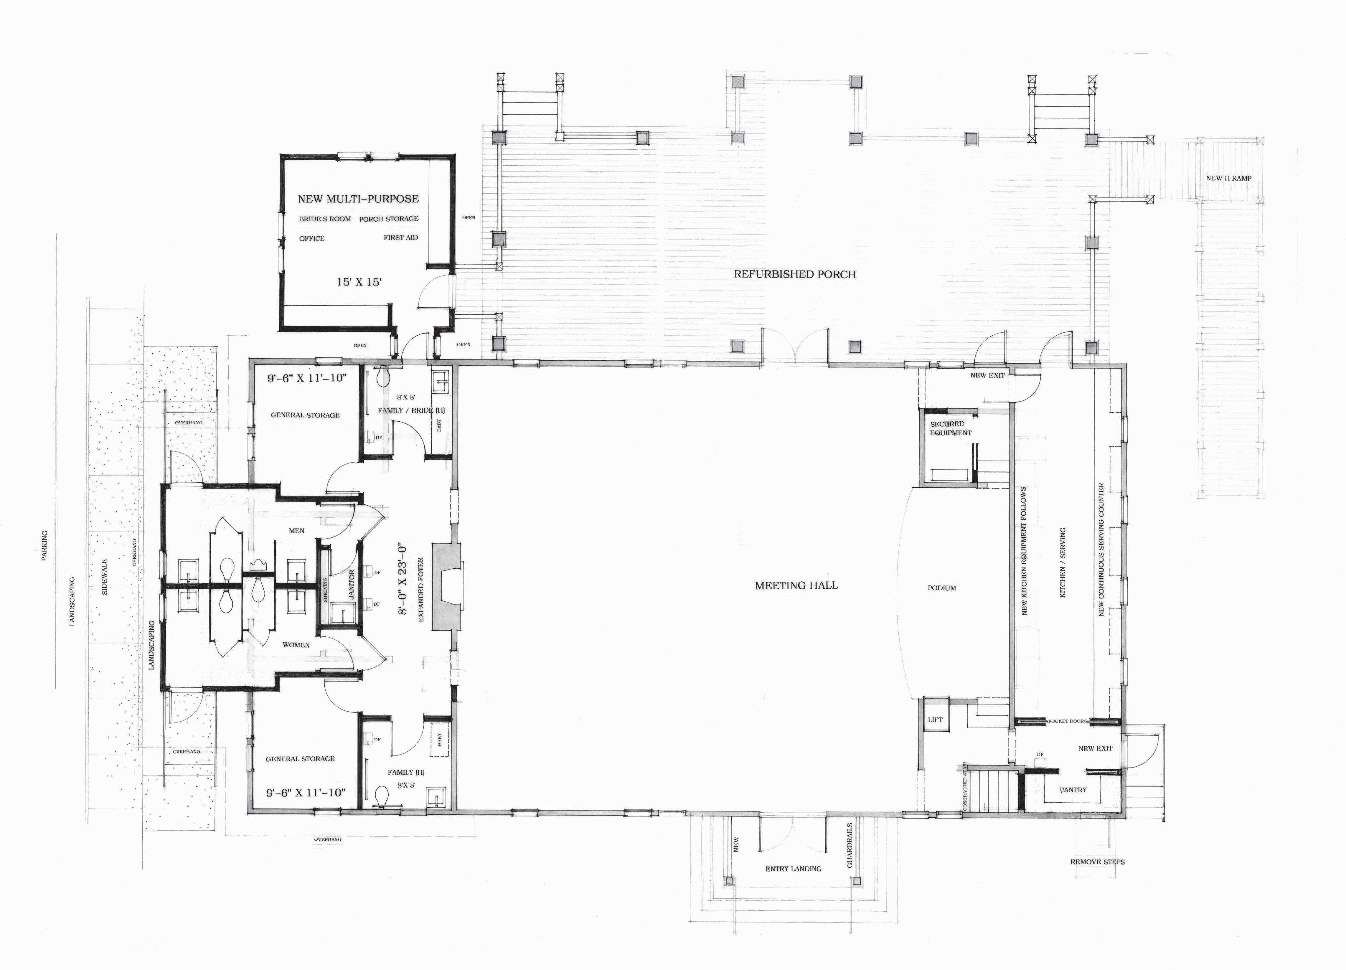
Revised Floor Plan

Slide 5
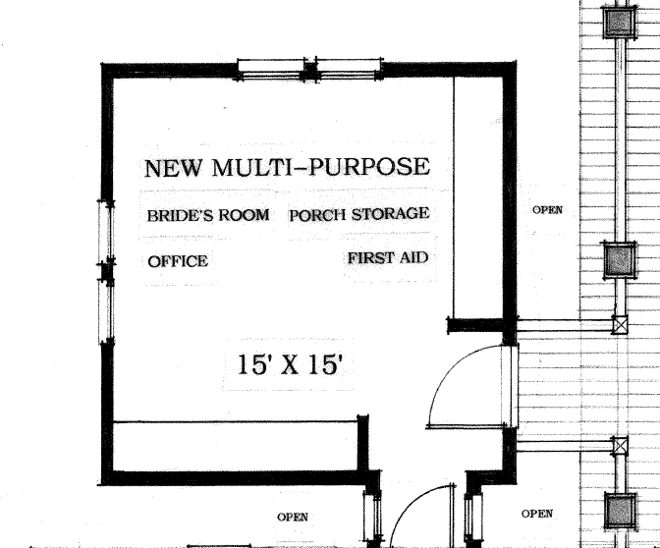
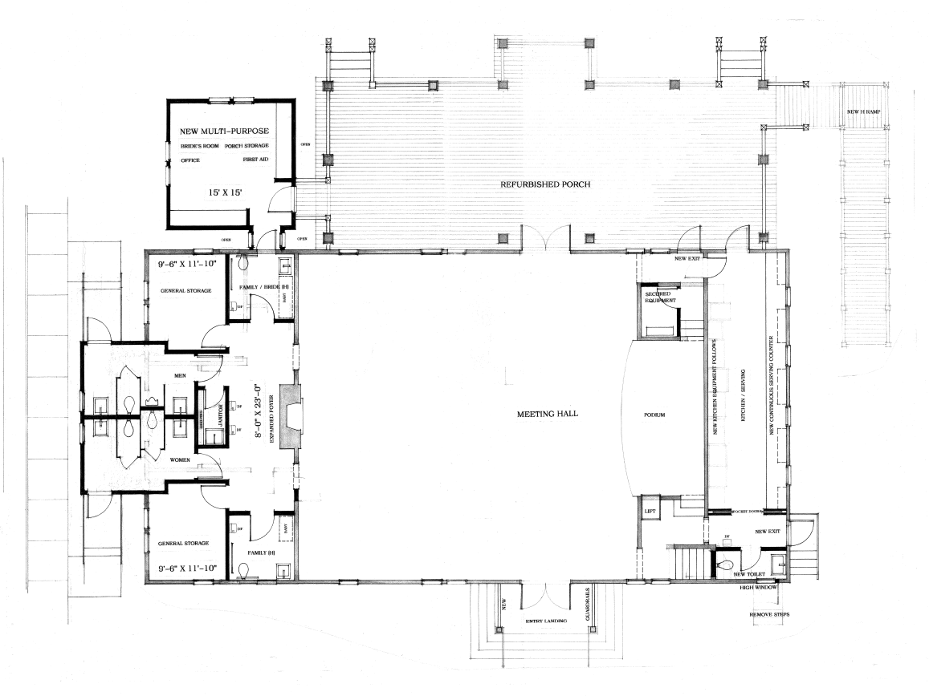
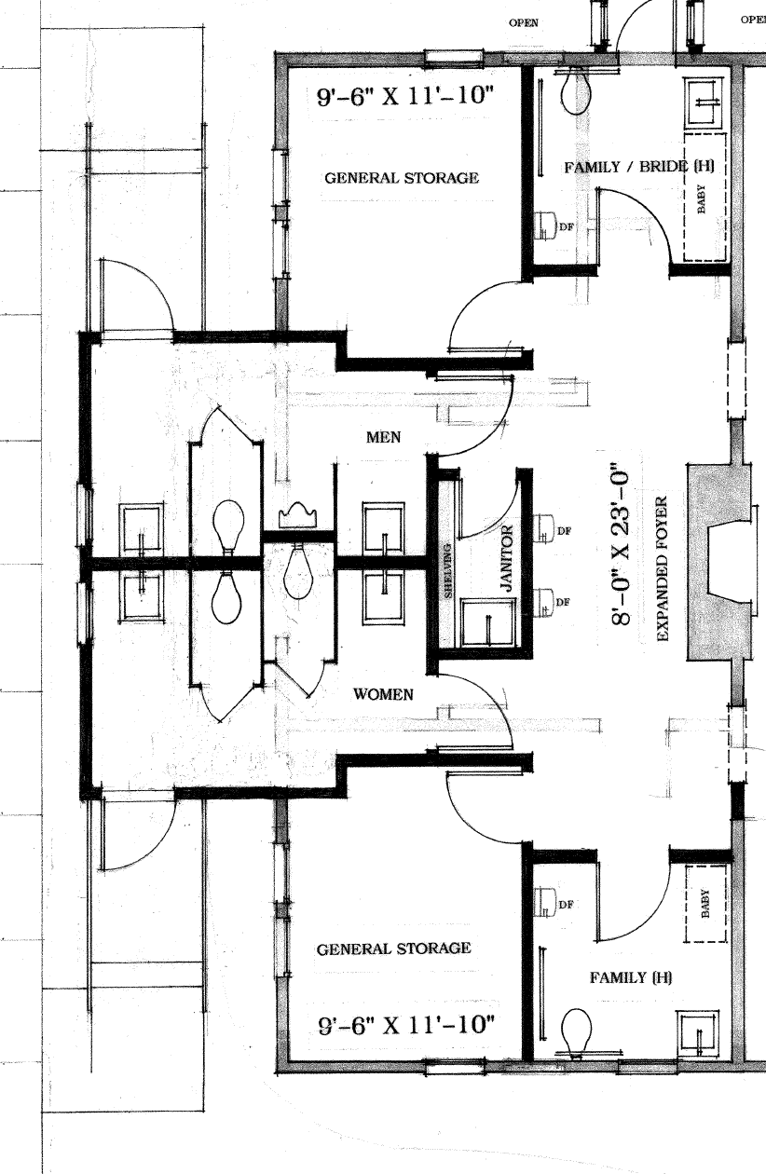
A
A
B
B

Slide 6
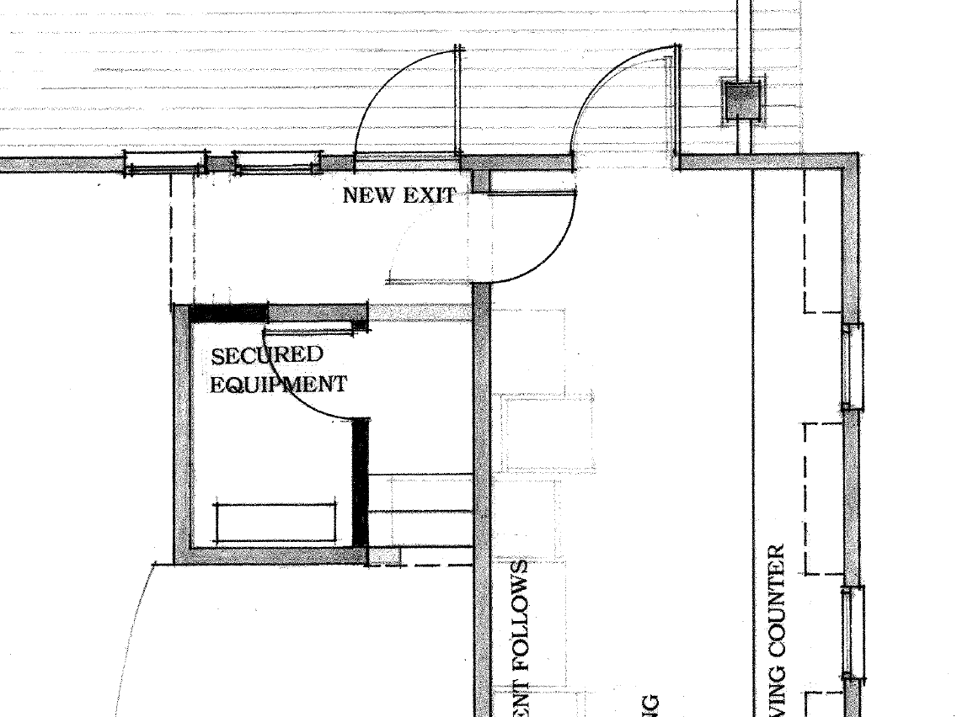
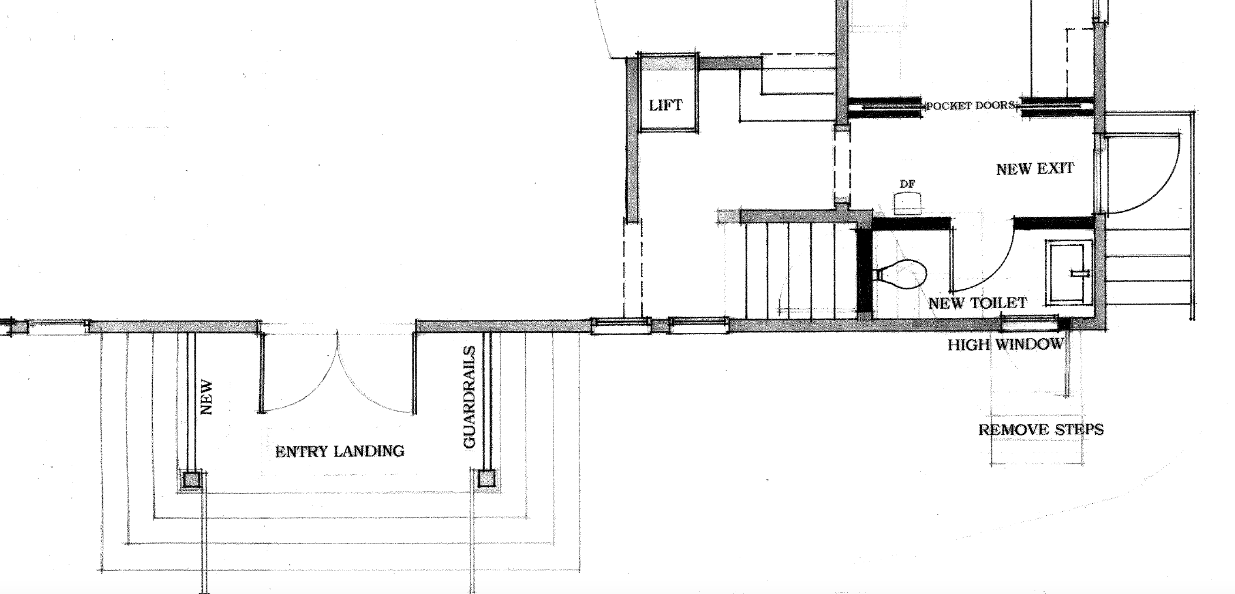
A
A
B
B

Slide 7
