Slide 1
Oakdale and 9th Permanent Diversion
Mike Woodward P.E.
Engineering Consultant
Tonya Elliott Moore
Public Works Director
Public Workshop
April 6, 2023

Slide 2
Overview
Town Council approved a temporary diverter for a 90-day trial
Diverter was approved to move forward to a permanent concept after the 90-day trial
We have three concepts to consider today
2

Slide 3
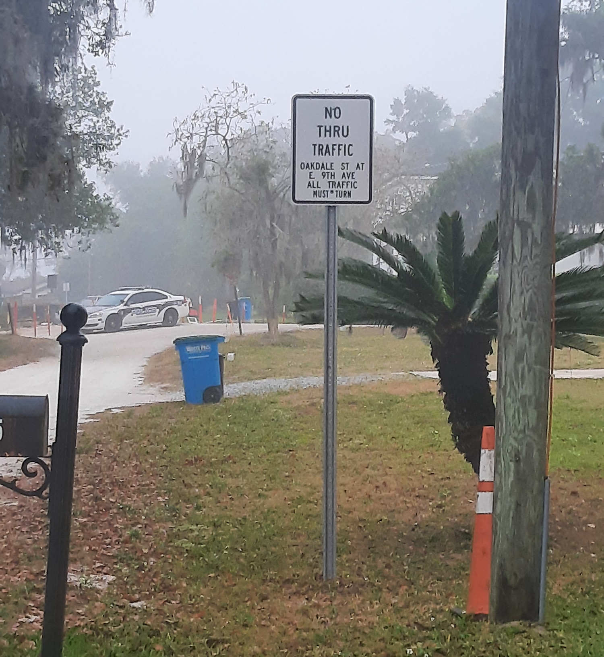
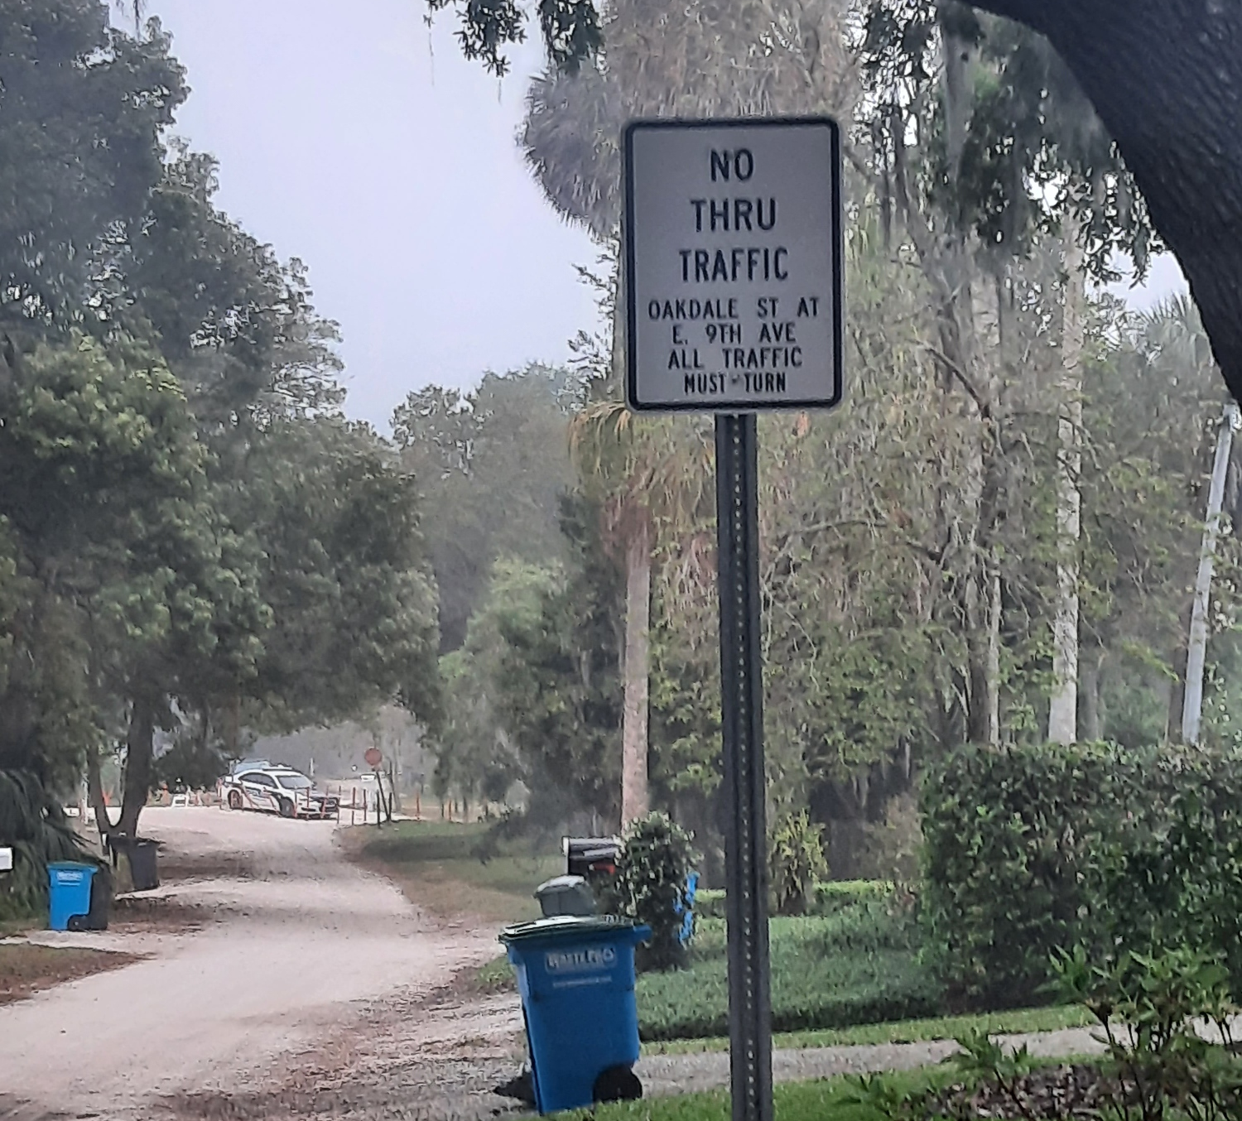
Concept 1: Signage
Remove the temporary barriers
Keep the signs in place
3

Slide 4
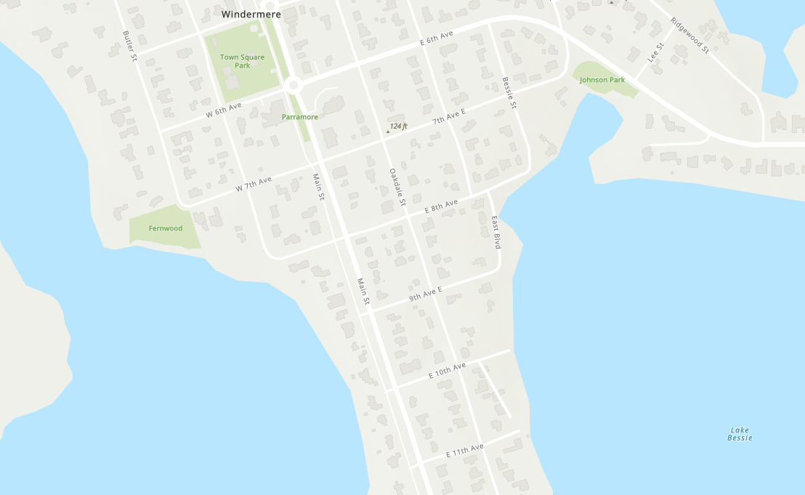
Signage
“All Traffic Must Turn”

Slide 5
Concept 2: Divertor with Middle Pass-Through
Pass-Through can be on the Northwest. Middle, or Southeast Side
Allows for golf carts, walkers, bike riders to pass through the diverter
Landscaping TBD: will be coordinated with the Garden Club
5

Slide 6
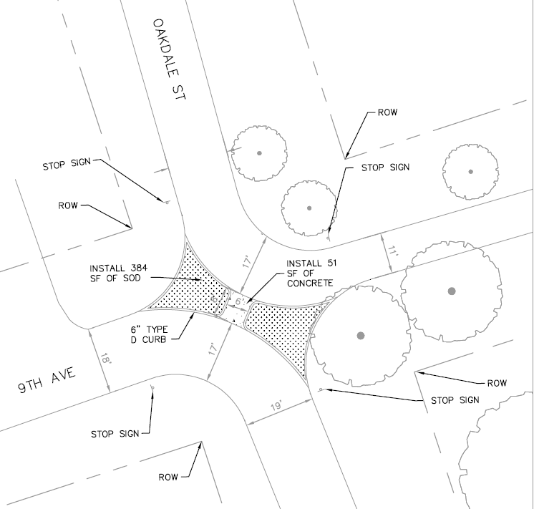
Middle Pass-Through: Plan View

Slide 7
Concept 3: Diverter with Side Pass- Through: Southeast
Pass through on the side (vs middle) provides a larger area for plantings and is easier to build & maintain.
Southeast (vs Northwest):
– better for drainage with less washout
– better constructability
7

Slide 8
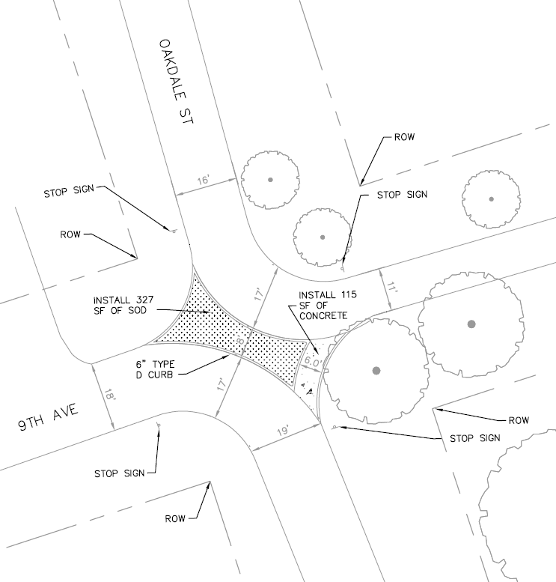
Diverter with South Side Pass-Through: Plan View
8

Slide 9
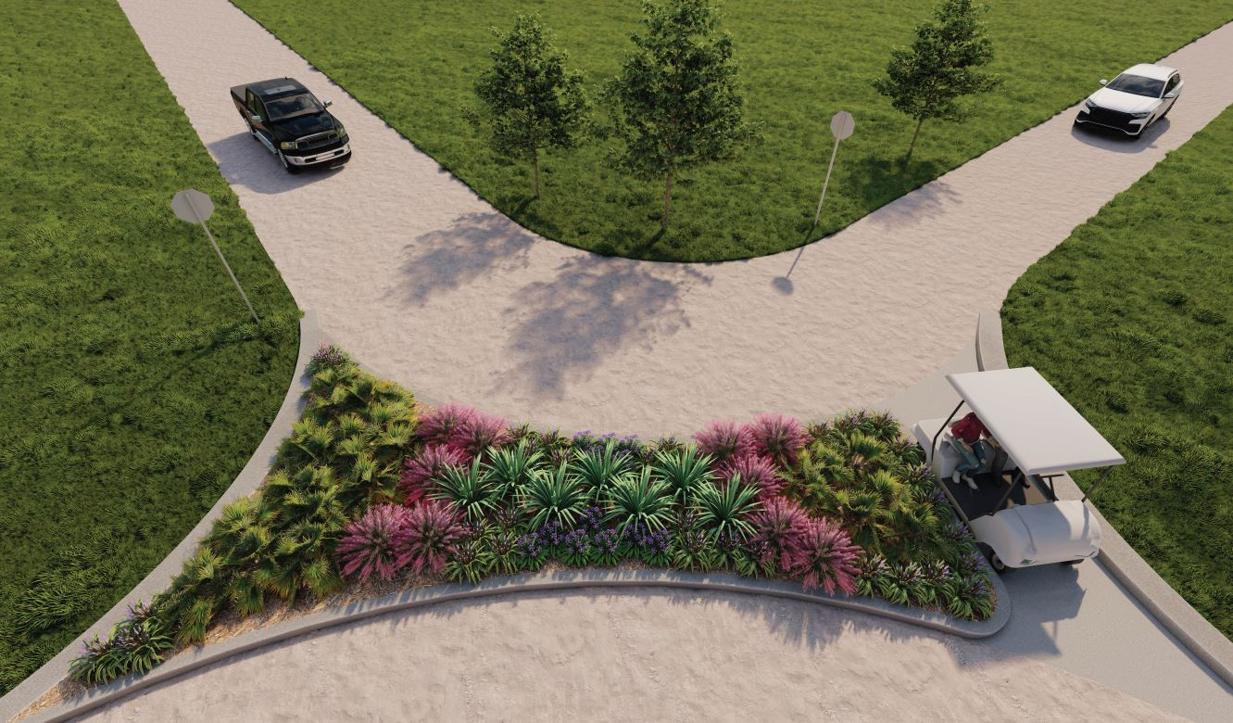
Southeast - 3d View (plantings TBD)
9

Slide 10
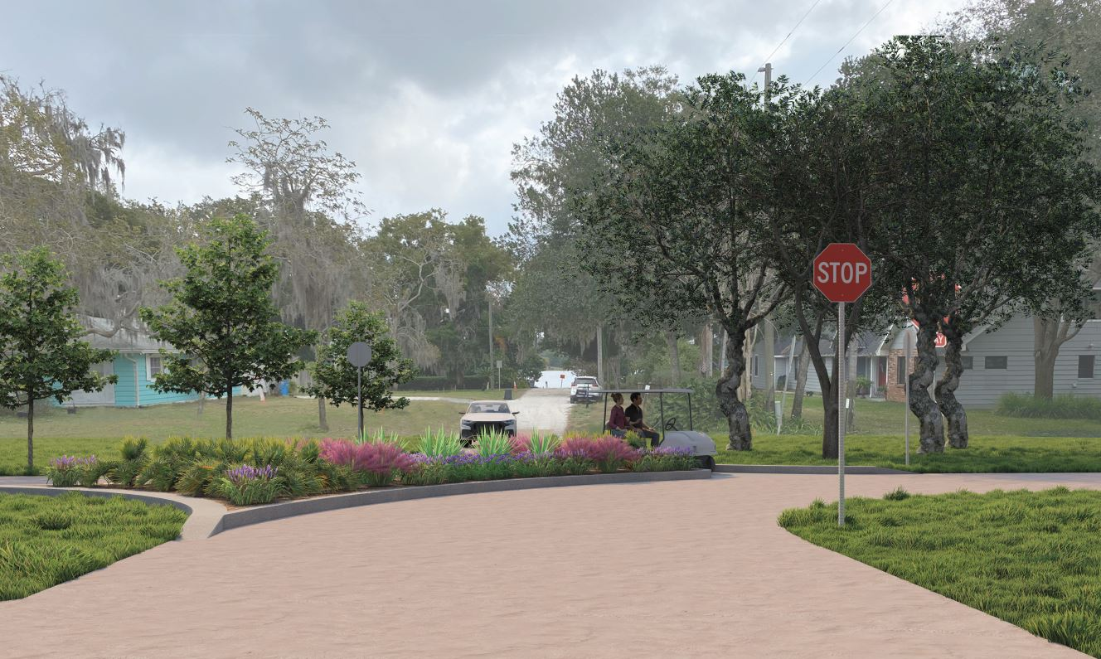
Southeast - 3d View (plantings TBD)
10

Slide 11
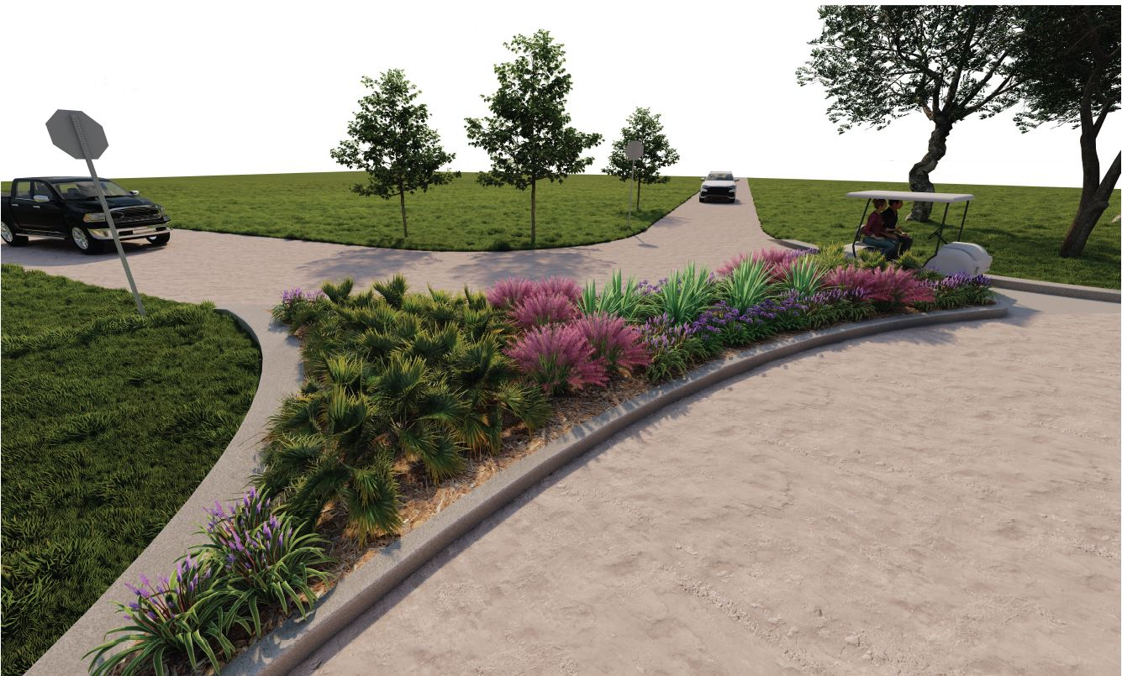
Southeast - 3d View (plantings TBD)
11

Slide 12
Thank you

