Slide 1
Ward Trail Design Workshop
December 16, 2021

Slide 2
Phase I Limits
From North Drive to Park Ave
0.6 miles
Includes Canal Bridge

Slide 3
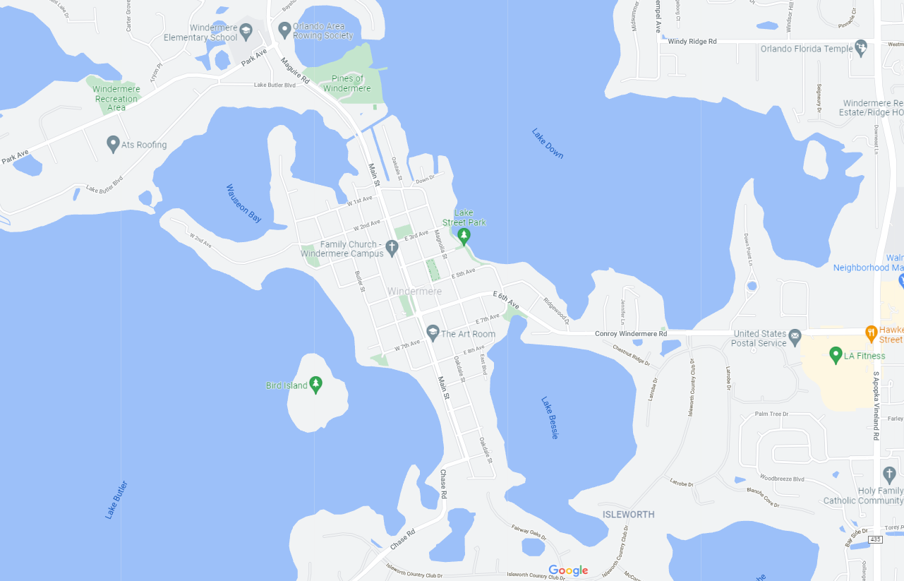
Future Phases
Phase II from 6th Ave to North Dr
Phase III – Along 6th Ave from Main St to Apopka Vineland Rd
Phase IV from Chase Rd / 12th Ave to 6th Ave

Slide 4
Overall Process and History
Concept Planning
Year 2020 & Earlier
Selection of Bridge Options
January 2021
Trail Design
Discussing 60% Plans Today
Funding
Several sources are being pursued by Town
Construction
Schedule TBD based on funding
Finalizing Design Spring 2022

Slide 5
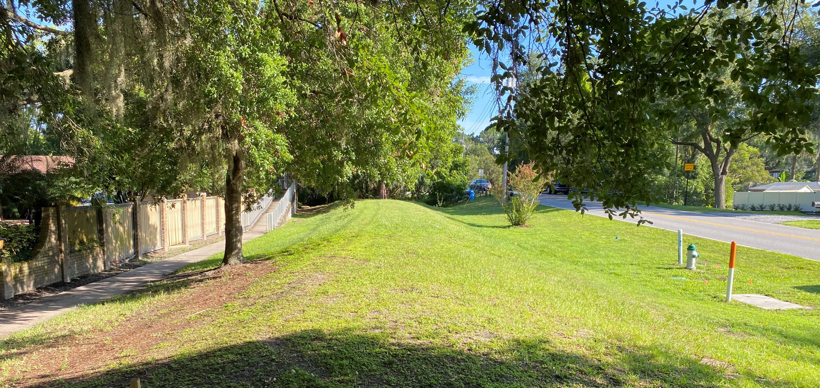
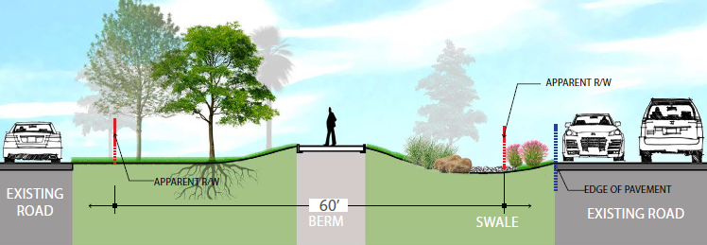
Typical Section

Slide 6
Bridge Examples
Color: Black
Height – 8 feet tall
Width – 14 feet wide
Deck – brushed concrete

Slide 7
Recommendations from Arborist Report
Root Protection Recommendations
Root Pruning or protection
Porous paving
Gravel base under trail
Additional recommendations for tree removal
Poor structure
Poor conditions
Invasive species
Recommended relocation of golf-cart connection to Lake Butler Blvd to avoid impacting Longleaf Pine

Slide 8
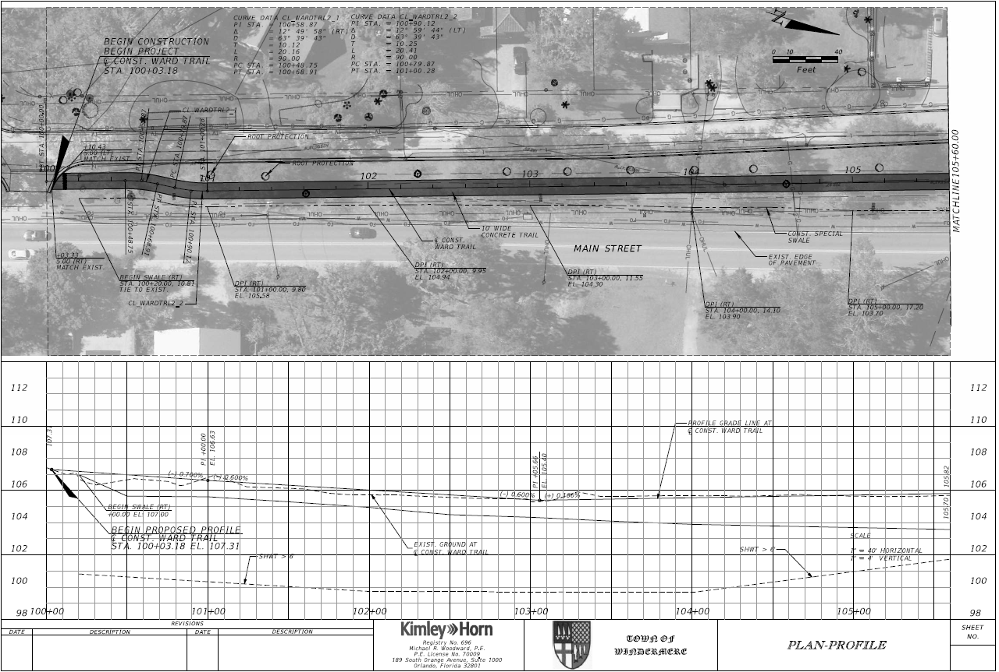
60% Design Plans: Plan and Profile

Slide 9
Questions and Comments
Tonya Elliot Moore
Director of Public Works
tmoore@town.windermere.fl.us
Mike Woodward. P.E.
Consultant Project Manager
mike.woodward@kimley-horn.com

