Slide 1
Downtown Windermere Properties Z19-12
Town Council First Public Hearing
April 13, 2021

Slide 2
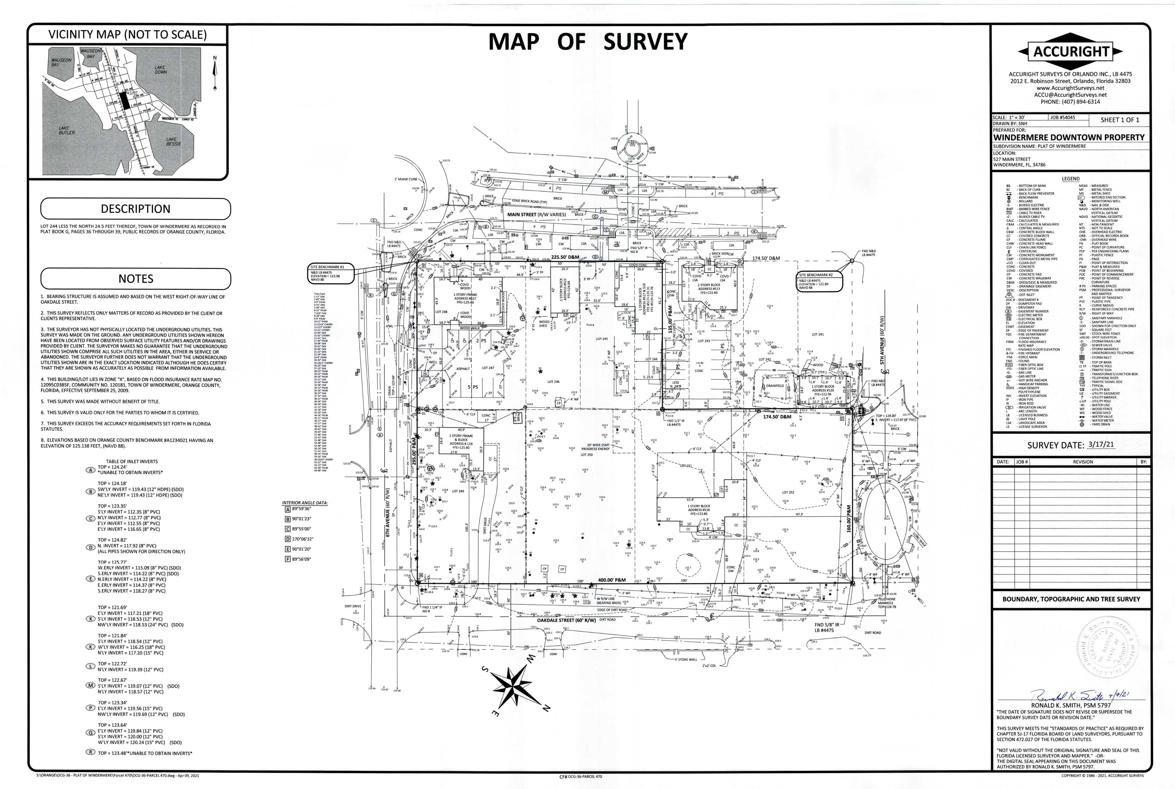
Project Location
Northeast Corner of Main Street and E 6th Avenue
2.17 acres +/-
Property Owner is Downtown Windermere Properties, LLC.
Existing Uses on the Property are a real estate office, insurance office, specialty retail, ice cream shop, and 2 single-family homes.

Slide 3
Planned Unit Development (PUD) Process
Pre-Application
2019
Conceptual Plan Review
DRB Individual Comments October 2020
Preliminary Development Plan (PDP)
(DRB-02/16/2021)
(TC -04/13/2021 & 06/08/2021)
Final Development Plan (Future Public Hearings with DRB and TC)
On February 16, 2021, the Development Review Board (DRB) held a public hearing and reviewed the proposed rezoning to PUD and the Preliminary Development Plan. The DRB recommend approval to the Town Council.

Slide 4
Purpose of PUD
Property is located with the Town Center Overlay District as adopted in the Town’s Comprehensive Plan.
Development within the District requires a rezoning to Planned Unit Development (PUD) with a Preliminary Development Plan.
Development must be consistent with all design standards of the Town Center Design Guidelines (2004).
Building and parking locations, buffering, parking, building façade, etc.

Slide 5
Purpose of PUD
Approval of the PUD and Preliminary Development Plan does not authorize development.
Only assigns the correct zoning, implements the adopted Town Center Master Plan, and sets limitations on development.
If the PUD and Preliminary Development Plan are approved – a Final Development Plan must be approved by the DRB and Town Council prior to development.

Slide 6
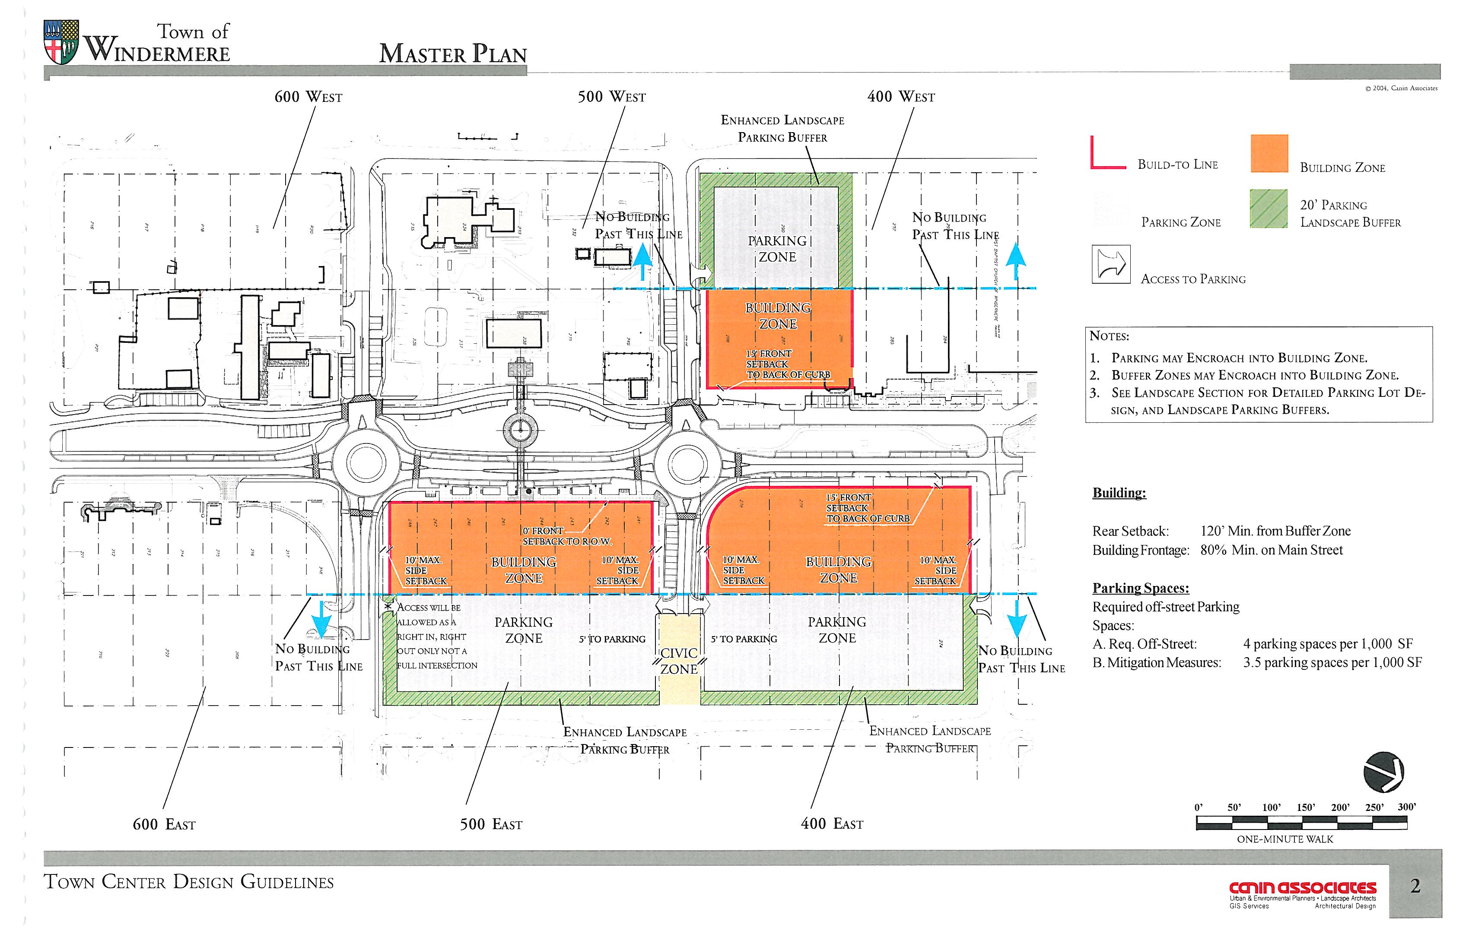

Slide 7
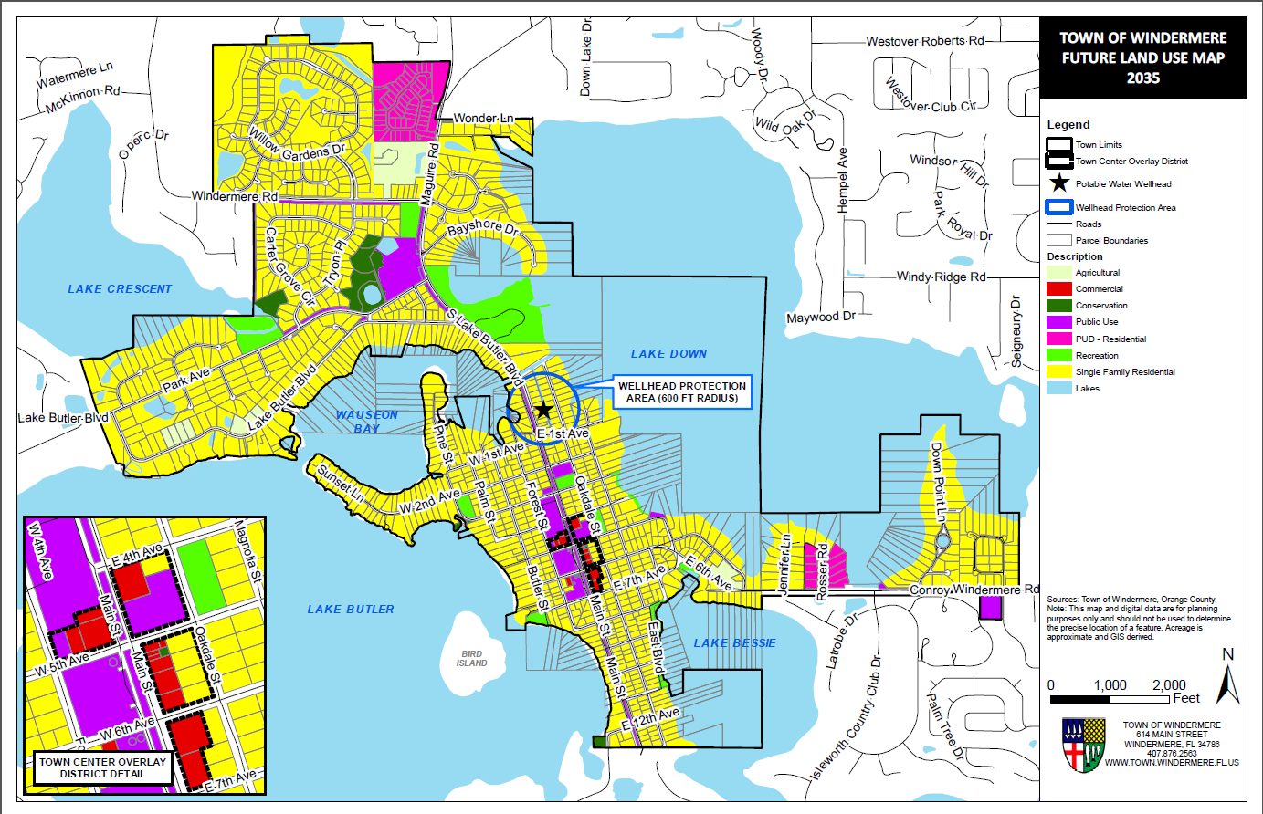

Slide 8
Proposed Project
Redevelop the property with up to 21,750 square feet of retail, restaurant, and office space.
Buildings no higher than 35 feet.
Internal off-street parking and stormwater.
Project boundary buffering.
Existing Development On-Site is Approximately 10,774 square feet of office, retail, ice cream shop, 2 single-family homes.
Net increase in building area on subject property is 10,976 square feet.

Slide 9
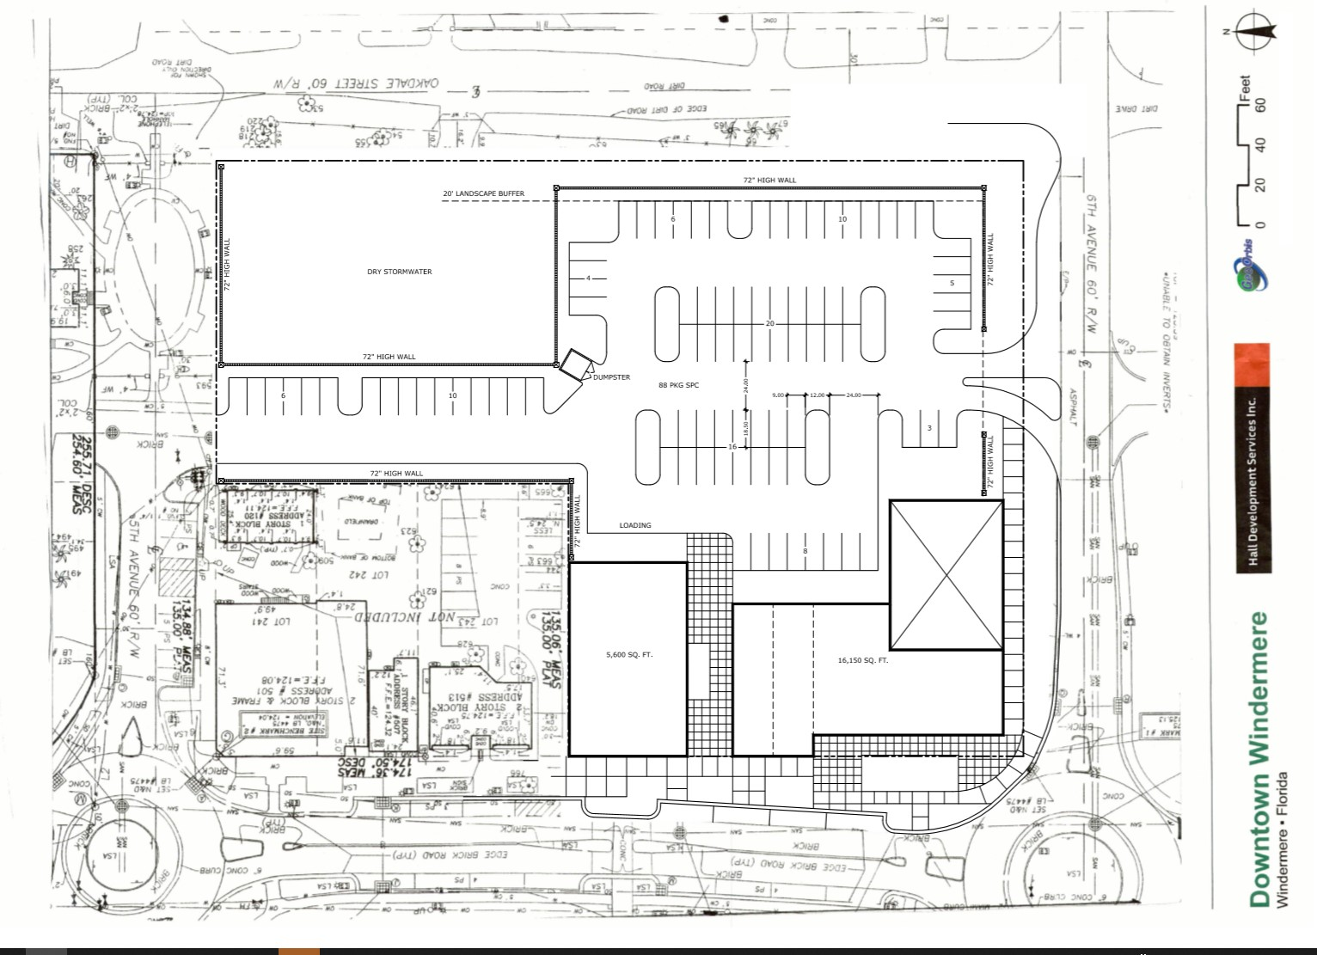
Proposed Preliminary Development Plan

Slide 10
Tree Impact
Applicant provided an updated tree survey on April 9, 2021.
The proposed development project, like any other project, is subject to the Town’s tree protection and mitigation ordinance. Trees that are protected under the Town’s ordinance must either be replaced or mitigated by the payment of a fee to the Town.
Tree mitigation will be determined at time of Final Development Plan.

Slide 11
Updated Tree Survey

Slide 12
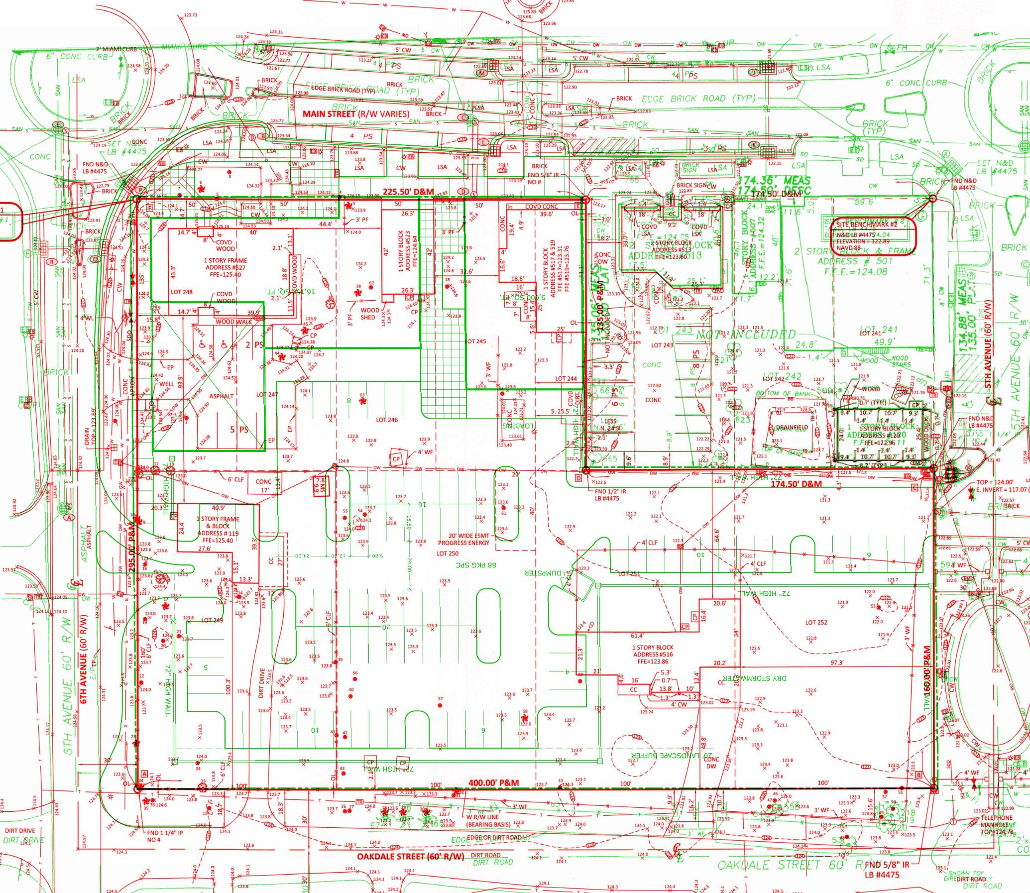
Updated Tree Survey

Slide 13
Traffic
The Applicant provided a traffic study to analyze the potential traffic impacts of the proposed project. The traffic study was also reviewed by the Town’s Consulting Engineer, Kimley-Horn & Associates (KHA).
KHA recommended that the proposed project include a right-hand turn lane into the property from west-bound E 6th Avenue. The Applicant has agreed to provide the recommended right-hand turn lane.
The Town is also in the process of considering improvements to the existing round-a-bout at E 6th Avenue and Main Street to improve the traffic flow.

Slide 14
Traffic
The Town Center Master Plan requires that the only traffic access to the property is from a right-in and right-out only driveway on E 6th Avenue and a full access driveway on E 5th Avenue. There is no access allowed on Oakdale Street.
Projected Net Change in Peak Hour Traffic (New Trips Less Existing Trips):
AM Peak Approximately 14 Trips
PM Peak Approximately 39 Trips
Average Peak Hour Change Approximately 27 Trips

Slide 15
Water and Sewer Services
The proposed project will have potable water services provided by Orange County Utilities.
The proposed project will use an on-site septic system for wastewater. The proposed on-site septic system has not yet been designed. It is required to be designed and provided on the Final Development Plan. The area that may be required for the on-site septic system may limit the amount of area available for the required parking, which may then reduce the size of the proposed buildings base on the available parking or on the requirement of the on-site septic system.

Slide 16
Façade/Elevation
Applicant request waiver to PUD submittal standards to provide facades/elevations of proposed buildings.
Applicant has acknowledged that the required design standards will be met and provided as part of the Final Development Plan

Slide 17
Proposed PUD Development Conditions
The proposed PUD conditions cover the following topics:
Mitigation Agreements for Transportation and Utilities as part of the Final Development Plan;
Final Development Plan Requirements – Emphasis on tree protection/mitigation and landscaping, stormwater management, Design Standard compliance, utilities, and buffering of surrounding properties;
Construction Management – Emphasis on construction staging and construction impacts;
Permitted land uses consistent with Town requirements; and
Town Council Workshops for review of drafts of Final Development Plan prior to final submission for public hearing.

Slide 18
Proposed PUD Development Conditions
The proposed PUD conditions were provided to the applicant late last week. Town staff is aware that the applicant may have proposed revisions to the conditions that will be provided at the 2nd Public Hearing in June.

Slide 19
Next Steps
PUD conditions may be revised and will be presented to Town Council at the 2nd public hearing on June 8, 2021.
The 2nd public hearing on June 8, 2021, is the final public hearing for the Town Council.
If Town Council approves the rezoning and preliminary development plan on June 8, 2021, then the applicant will prepare the Final Development Plan for additional public hearings with the Town’s Development Review Board and Town Council.
No development is authorized until the Town Council approves the Final Development Plan.

