Slide 1
Downtown Windermere Properties PUD Rezoning and Preliminary Site Plan Frequently Asked Questions

Slide 2
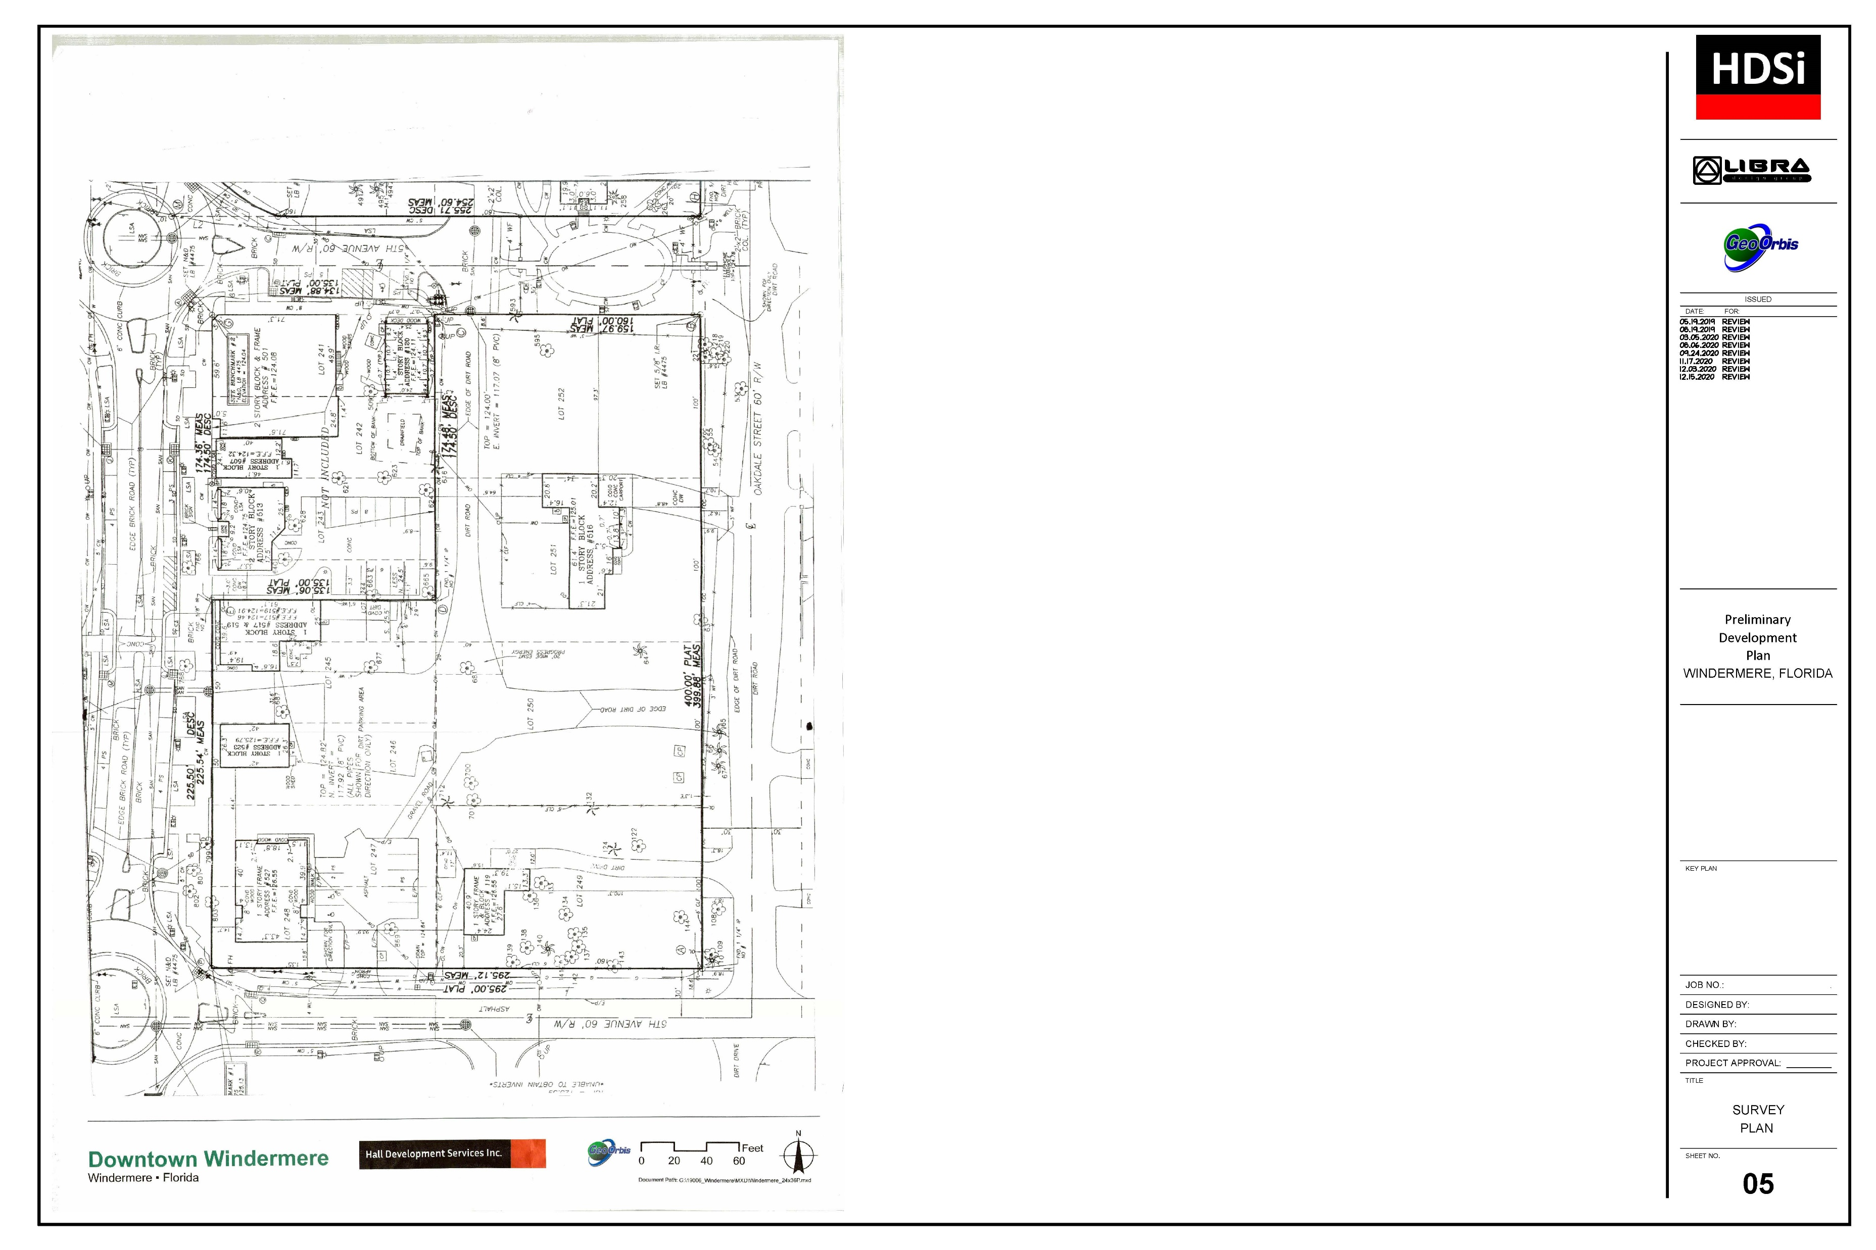
Where is the Project Location?
Northeast Corner of Main Street and E 6th Avenue
2.17 acres +/-
Existing Buildings will be removed

Slide 3
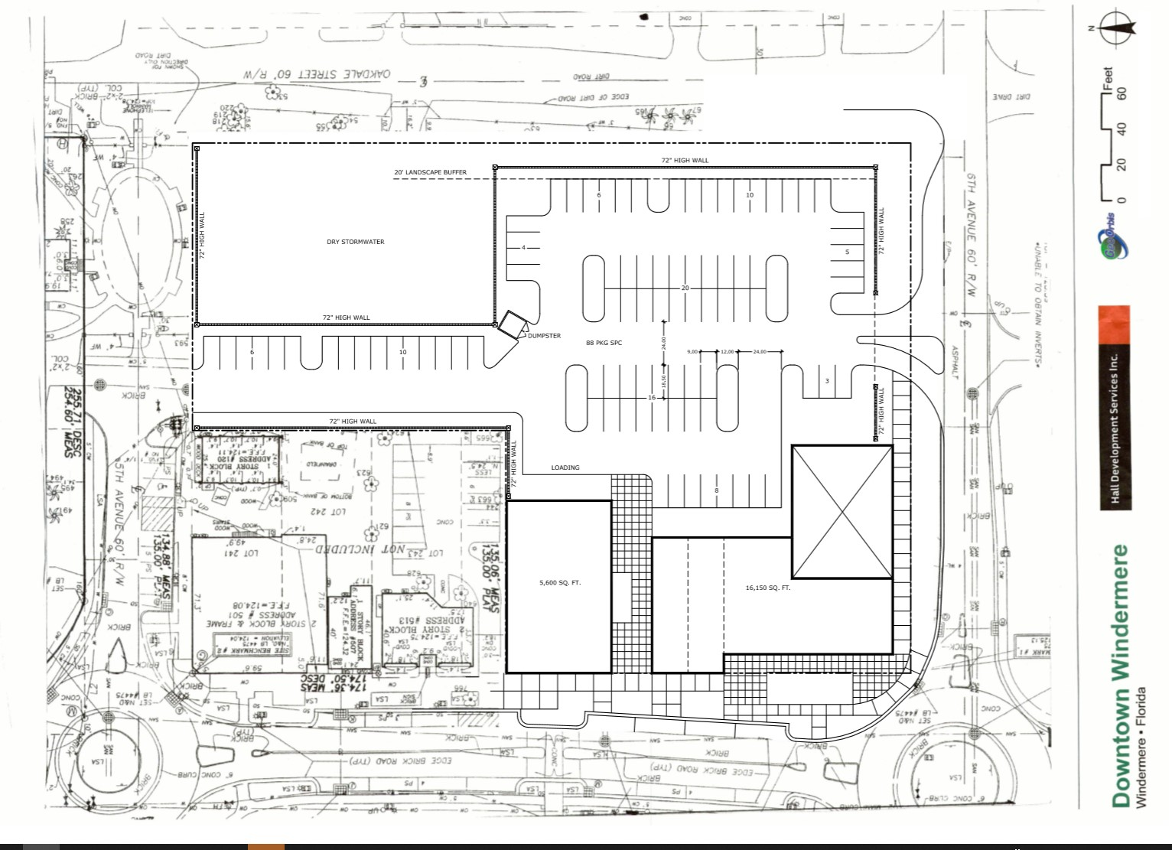
What is the Proposed Project?
Redevelop the property with up to 21,750 square feet of retail, restaurant, and office space.
Buildings no higher than 35 feet.
Internal off-street parking and stormwater.
Project boundary buffering.

Slide 4
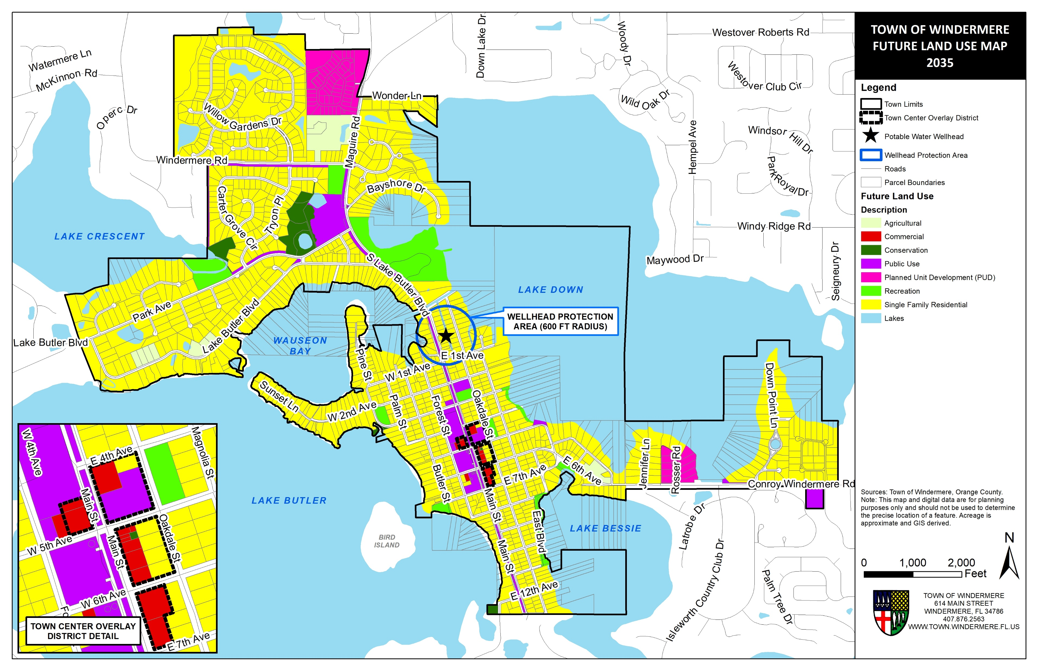
What is the Property’s Future Land Use and Zoning?
The property has a Future Land Use and Zoning of Commercial and Residential within the Town Center Overlay District.

Slide 5
How can the Property be Developed with Commercial Uses with a Portion of the Property as Residential?
The entire property (both the Commercial and Residential area) is within the Town’s adopted Town Center Master Plan and Overlay District.
The Town Center Master Plan and Overlay District allow the property to be developed with Commercial uses as long the development is consistent with the Town Center Master Plan.
The Town Center Master Plan requires that the development of the property has the buildings placed on the frontage of Main Street with the area of the property fronting Oakdale Street limited to parking, landscape buffer, and stormwater.

Slide 6
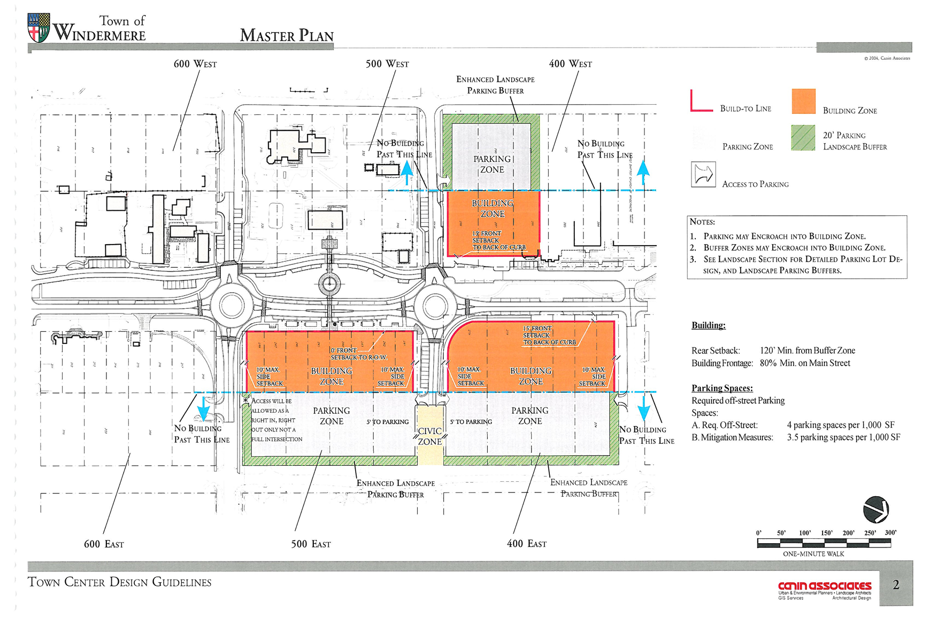
What is the Town Center Master Plan and Overlay District?
In 2004, the Town adopted a master plan to guide the redevelopment of properties within the Downtown area.
The Town Center Master Plan identifies how the properties must be redeveloped.

Slide 7
What is the Town Center Master Plan and Overlay District?
The Town Center Master Plan requires:
Buildings located along Main Street.
Parking and Buffering located along Oakdale Street.
Limits access to only E 6th Avenue (right-in and right-out) and to E 5th Avenue.

Slide 8
What is the Town Center Master Plan and Overlay District?
The Town Center Master Plan requires:
Requires 20-foot landscape buffer and 6-foot wall along Oakdale Street and portion of E 6th Avenue.
Requires certain architectural building characteristics to maintain character of Town.

Slide 9
What is the Town Center Master Plan and Overlay District?
The Town Center Master Plan and Overlay District are adopted and implemented in:
The Town Center Design Guidelines
The Town’s Land Development Regulations in Section 3.05.00.
The Town’s Comprehensive Plan in Policy 1.4.21 of the Future Land Use Element and Future Land Use Map

Slide 10
What Approvals are Required for the Proposed Project?
The Proposed Project requires the following approvals by the Town Council:
Rezoning of the Property to Planned Unit Development (PUD);
2. Approval of a Preliminary Site Plan; and
Approval of a Final Development Plan.
The Town’s Comprehensive Plan requires all new development within the Town Center Overlay District to be rezoned to PUD.
The PUD rezoning process provides the opportunity for the Town Council and the residents of the Town to review projects within the Town Center Overlay District.

Slide 11
What is the PUD Process?
Conceptual Plan Review
DRB Individual Comments October 2020
Preliminary Site Plan (PSP)
(DRB-02/16/2020)
(TC -04/13/2021 & 06/08/2021)
Final Development Plan (Future Public Hearings with DRB and TC)
The Proposed Project is in the Preliminary Site Plan portion of the PUD process.
Approval of the PUD and Preliminary Site Plan does not authorize development. It only assigns the correct zoning and sets limitations on development.
The Development Review Board (DRB) recommended approval of the PUD rezoning and Preliminary Site Plan on 02/16/2021.
Town Council public hearings are scheduled for 04/13/2021 and 06/08/2021.
If the PUD and Preliminary Site Plan are approved, then a Final Development Plan must be approved by the Development Review Board and Town Council through additional public hearings prior to development.

Slide 12
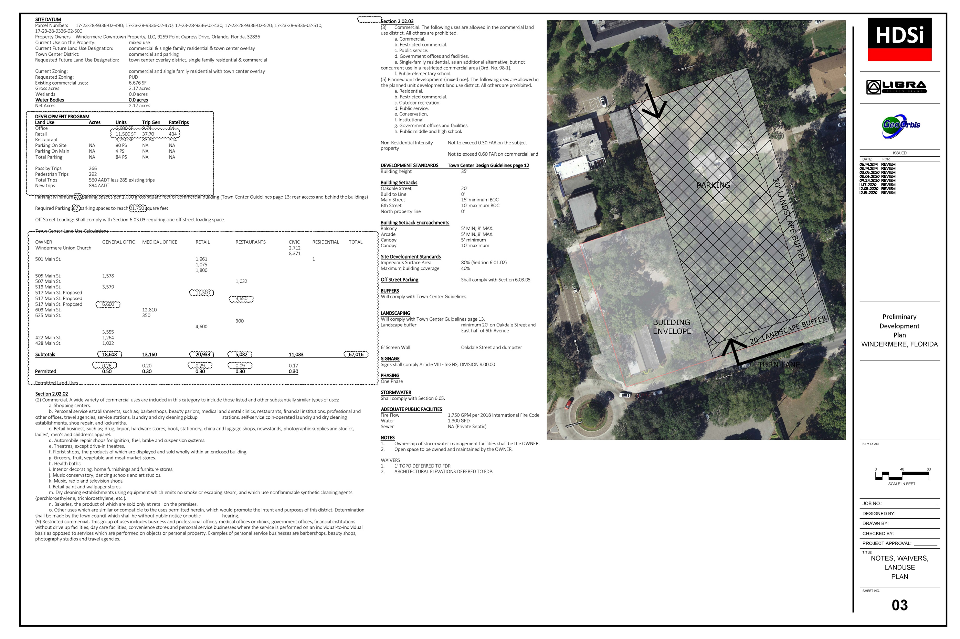
What is the Purpose of the PUD Process?
The purpose of the PUD process is to assure that the proposed development is compliant with the requirements of the Town Center Design Guidelines and to provide for compatibility with surrounding uses through appropriate buffering and site design.

Slide 13
What is the Purpose of the Preliminary Site Plan?
The purpose of the Preliminary Site Plan is to provide a general concept of the proposed development. The Preliminary Site Plan establishes the maximum potential development. However, this maximum potential development may be reduced as further engineering and site analysis occurs for the proposed project.
The additional engineering and site analysis occurs with the next phase of the PUD process with the Final Development Plan. The Final Development Plan requires that all site engineering must be fully complete, and the final development is fully designed for construction.

Slide 14
Are Any Waivers or Variances Being Requested?
The Applicant has requested two waivers to the submission requirements for the Preliminary Site Plan:
Requested Waiver to Providing One-Foot Topography Lines on Preliminary Site Plan; and
Requested Waiver to Providing Proposed Actual Building Façade Drawings.
The Applicant has committed to follow the required building façade requirements of the Town Center Design Guidelines and the façade characteristics of the new Town Administration Facilities and new Micro-Brewery on W 5th Avenue.
The Applicant is not requesting any waivers or variances to the site development standards of the Town Center Design Guidelines.

Slide 15
Will the Existing Trees on the Property be Protected?
The Applicant is preparing an updated tree survey to be provided as part of the Final Development Plan.
The proposed development project, like any other project, is subject to the Town’s tree protection and mitigation ordinance. Trees that are protected under the Town’s ordinance must either be replaced or mitigated by the payment of a fee to the Town.

Slide 16
How will the Proposed Project Impact Traffic?
The Applicant provided a traffic study to analyze the potential traffic impacts of the proposed project. The traffic study was also reviewed by the Town’s Consulting Engineer, Kimley-Horn & Associates.
In review of the traffic study, Kimley-Horn & Associates recommended that the proposed project include a right-hand turn lane into the property from west-bound E 6th Avenue. The Applicant has agreed to provide the recommended right-hand turn lane.
The right-hand turn lane will help address traffic coming to the property by removing the traffic entering into the property from the queue going into the round-a-bout at E 6th Avenue and Main Street.
The Town is also in the process of considering improvements to the existing round-a-bout at E 6th Avenue and Main Street to improve the traffic flow.

Slide 17
How will the Proposed Project Impact Traffic?
The Town Center Master Plan requires that the only traffic access to the property is from a right-in and right-out only driveway on E 6th Avenue and a full access driveway on E 5th Avenue. There is no access allowed on Oakdale Street.

Slide 18
How will Water and Sewer Services be Provided?
The proposed project will have potable water services provided by Orange County Utilities.
The proposed project will use an on-site septic system for wastewater. The proposed on-site septic system has not yet been designed. It is required to be designed and provided on the Final Development Plan. The area that may be required for the on-site septic system may limit the amount of area available for the required parking, which may then reduce the size of the proposed buildings base on the available parking or on the requirement of the on-site septic system.

Slide 19
How will the Existing Homes on the East-side of Oakdale Street be Protected?
The Town Center Master Plan and Design Guidelines require a minimum 20-foot landscaped buffer with a solid 6-foot wall along the Oakdale Street boundary of the proposed project.
The landscape within the 20-foot buffer must be placed on the side of the wall facing Oakdale Street.
The landscaped buffer and wall must be placed on the property and cannot use any of the Oakdale Street right-of-way.
The details of the landscape plan for the 20-foot buffer have not yet been developed. They will be provided as part of the Final Development Plan.
The Town Council through the PUD process has the authority to require additional buffering.

Slide 20
Are There Other Permitting Agencies Required?
Prior to any development activity, the following additional permits are required from other agencies:
Orange County Health Department for the On-Site Septic System
Orange County Utilities for Connection to Potable Water
South Florida Water Management District for Stormwater

Slide 21
How Can I Provide Comments on the Proposed Project?
Comments on the proposed project may be provided in several ways:
Email comments to the Town’s Planning Consultant, Brad Cornelius, at bcornelius@wadetrim.com
Mail comments to the Town’s Planning Consultant at the following address:
Wade Trim, Inc.
Attn: Brad Cornelius
201 N. Franklin Street, Suite 1350
Tampa, FL 33602
3. Drop comments off to Town Administration at 501 Forest Street
4. Attend Town Council Public Hearings on:
April 13, 2021 @ 6:00 p.m.
June 8, 2021 @ 6:00 p.m.

