Slide 1
Downtown Windermere Properties Z19-12
Development Review Board
February 16, 2021

Slide 2
Planned Unit Development (PUD) Timeline
Pre-Application
2019
Conceptual Plan Review
DRB Individual Comments October 2020
Preliminary Development Plan (PDP)
(DRB-02/16/2020)
(TC -03/23/2021 & 05/11/2021)
Final Development Plan (Future Public Hearings with DRB and TC)
Original PUD request submitted in June 2019 included a third building that was inconsistent with the Downtown Master Plan and proposed amendments to the Town’s Comprehensive Plan.
The revised PUD request submitted in August 2020 removed third building and proposed comprehensive plan amendment.

Slide 3
Purpose of PUD
Property is located with the Town Center Overlay District as adopted in the Town’s Comprehensive Plan
Development within the District requires a rezoning to Planned Unit Development (PUD) with a Preliminary Development Plan
Development must be consistent with all design standards of the Town Center Design Guidelines (2004)
Building and parking locations, buffering, parking, building façade, etc.

Slide 4
Purpose of PUD
Approval of the PUD and Preliminary Development Plan does not authorize development
Only assigns the correct zoning and sets limitations on development
If the PUD and Preliminary Development Plan are approved – a Final Development Plan must be approved by the DRB and Town Council prior to development.

Slide 5
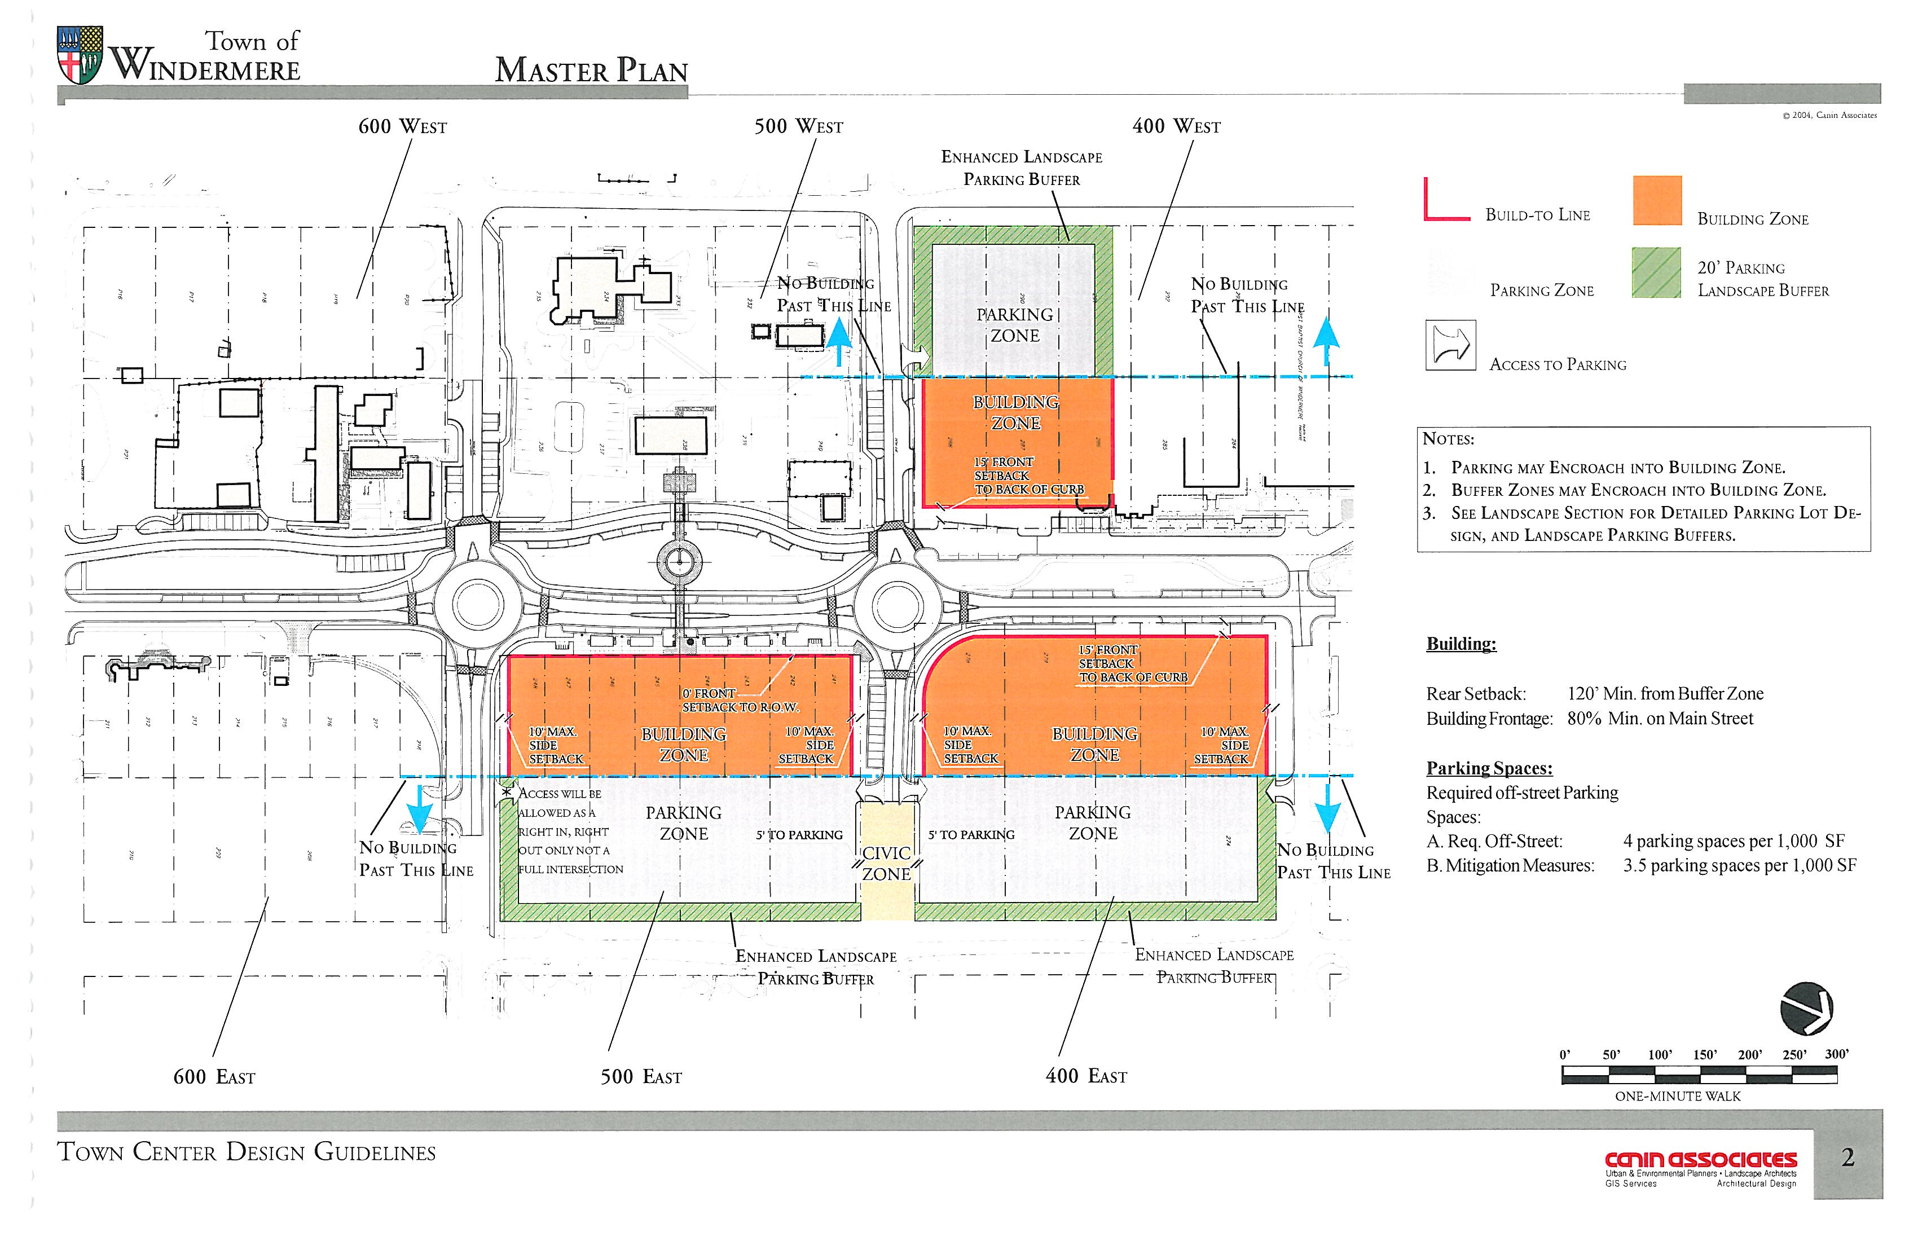

Slide 6
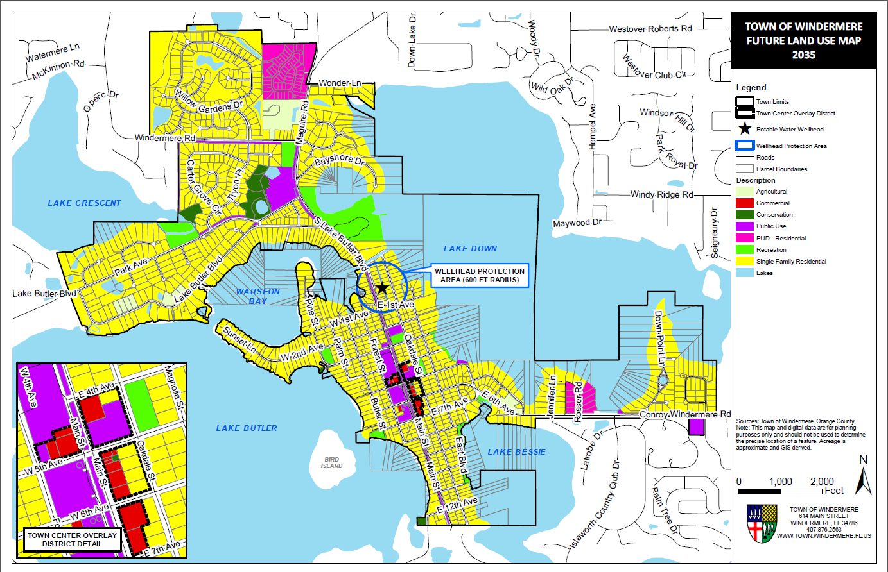

Slide 7
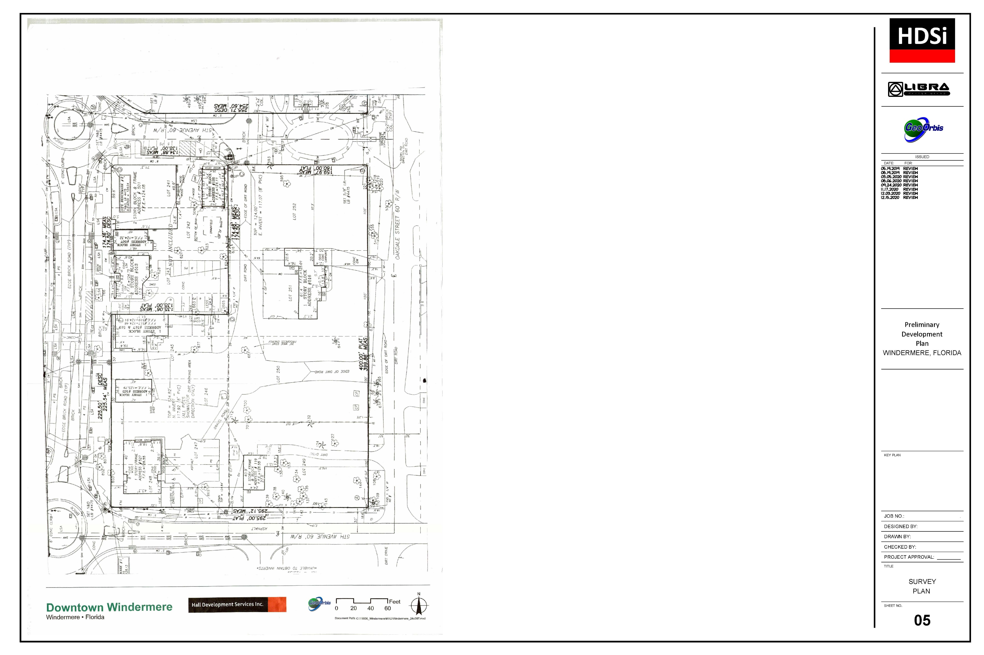
Project Location
Northeast Corner of Main Street and E 6th Avenue
2.17 acres +/-
Access only to E 6th Avenue and E 5th Avenue
No Access on Oakdale Street
20’ Buffer with 6’ wall and landscaping along Oakdale Street

Slide 8
PUD Requirements
Requirement | Provided
Project Name | Missing project name
Legal Description | Yes
Total Acreage | Yes
Location Map | Yes
Contact information for the owners, developers and the consultants involved in the preliminary development plan | Yes
Plan legend including north arrow, scale, and date. | Yes
Preliminary survey information showing the existing tree dimensions and locations on the site. For six inches or greater caliper trees, a tree impact plan must be provided. | Survey provided is outdated. Tree impact plan is from a previous project from 2006 (Main Street Shoppes).
A traffic study may be requested by the town manager. | Traffic study completed by Luke Transportation Engineering Consultants, Inc. date December 19, 2019. Reviewed for Town by Kimley Horn. Right-turn lane from westbound E 6th Avenue into project site required. Traffic study and Kimley Horn review attached as Attachment “B”
Existing topography at one-foot contours and other natural features including lakes, water bodies, conservation area, soils, and flood hazard areas. | Not provided. Applicant requests waiver to requirement.
Existing and proposed land uses, with each phase of the total development identified, if applicable. | Yes – Project one phase
Town Center Types of Uses | Yes – Retail/Office/Restaurant
Gross Floor Area | There are inconsistencies with the proposed gross floor areas. See staff report for discussion of inconsistencies.
Floor Area Ratio | Applicant provides the maximum limitations, but does not provide the proposed FAR.
Building Height | Applicant acknowledges the maximum 35 foot height limitation but does not provide the proposed height.
Setbacks | Provided, but not all setbacks are accurate due to poor quality of site plan document (property lines not easily visible).

Slide 9
PUP Requirements continued…..
Open Space | Not Applicable
Parking Spaces | Yes, but the site plan does not accurately reflect the stated amount of parking spaces, nor does it provide required handicapped parking, and the size of the spaces are inconsistent.
Service Access | Yes, loading zone shown.
Landscape Buffers | Yes, shows required 20 foot buffer and wall along Oakdale, but does not show detail. Acknowledges buffer requirement.
Identify the phasing of development and the manner in which each phase of development will exist as an independent development unit. | One phase.
The location of local streets proposed in the development, right-of-way widths, street setbacks, planned rights-of-way, the location of access points to abutting streets and projected traffic generation based on established International Traffic Engineer (ITE) standards. A traffic study may be required at the discretion of the town manager. | Traffic study completed by Luke Transportation Engineering Consultants, Inc. date December 19, 2019. Reviewed for Town by Kimley Horn. Right-turn lane from west-bound E 6th Avenue into project site required. Traffic study and Kimley Horn review attached as Attachment “B”. The location of the streets is shown; however, a defined property line is not provided. Right-of-way width is not clearly illustrated on the site plan.
Buffer treatment to adjacent uses. | Yes, shows required 20 foot buffer and wall along Oakdale, but does not show detail
All building elevations and architectural character. Sketches at appropriate scale to provide sufficient detail for review. | No. Applicant provides example façade images and states the Town Center Design Guidelines will be met. No project specific sketches provided. Applicant requests a waiver for this requirement.
Water service (including fire flows), plus gallons per day requirement. | Yes
Sewage disposal, plus gallons per day generated, unless septic systems are used. | No. Applicant states that sewer will be a private septic. Does not show location of septic tank nor does it show location of drainfield. Actual development may be less than depicted due to losss of developable area for drainfield (reduced areas for parking and to support building uses)
Stormwater management concept. | Only the location of the stormwater retention area is provided. No calculations or design information provided.
Parks/recreation facilities. | Not Applicable
Waivers from this Land Development Code or the site development standards of the PUD district shall be indicated on the preliminary development plan and/or submitted in writing. | Topography and Elevation/façade waivers requested.

Slide 10
Town Center Design Guideline Requirements
Requirement | Compliance Status
Rear Building Setback: 120' from buffer zone | When scaled the buildings meet the 120’ setback from buffer zone.
Building Frontage: 80% on Main St. | When scaled the buildings meet the 80% building frontage requirement.
Required off-street parking 4 parking spaces/every 1,000 square feet | Depends on accurate proposed gross floor area of buildings. Current plans say they are required 87 spaces, but the site plan only shows 85 spaces. No handicap spaces shown. Space size is inconsistent.
All Façade Design Standards | Façade design/Elevation information not provided. However, applicant states they will meet the Town Center Design Guideline standards.
Maximum Building Height: 35' | Façade design/Elevation information not provided. However, applicant states they will meet the Town Center Design Guideline standards.
Minimum Base building height: 12' | Façade design/Elevation information not provided. However, applicant states they will meet the Town Center Design Guideline standards.
Screenwall Materials:
Brick or stone | No information Provided. However, applicant states they will meet the Town Center Design Guideline standards.
Stucco wall, consistent with character of new building | No information Provided. However, applicant states they will meet the Town Center Design Guideline standards.
Hedges shall be selected from the shrub list and shall be 36" in height. | No information Provided. However, applicant states they will meet the Town Center Design Guideline standards.
Screenwall Configuration:
Shall be located at all parking lots in conjunctions with the 20' enhancement landscape buffer | Yes, as stated on site plan. Needs to be confirmed with the delineation of property lines.
Shall be 6' in height | Yes

Slide 14
Public Response Map
7 in support
8 in opposition
2 undecided

Slide 15
ADDITIONAL PLAN SHEETS IF NEEDED

Slide 17
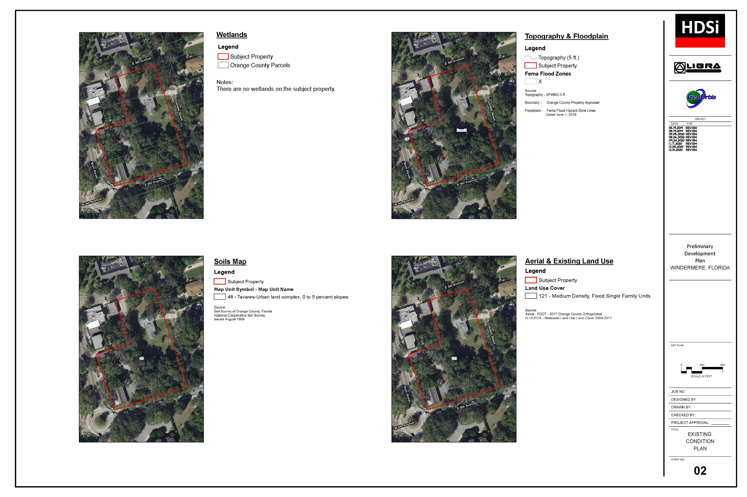

Slide 18
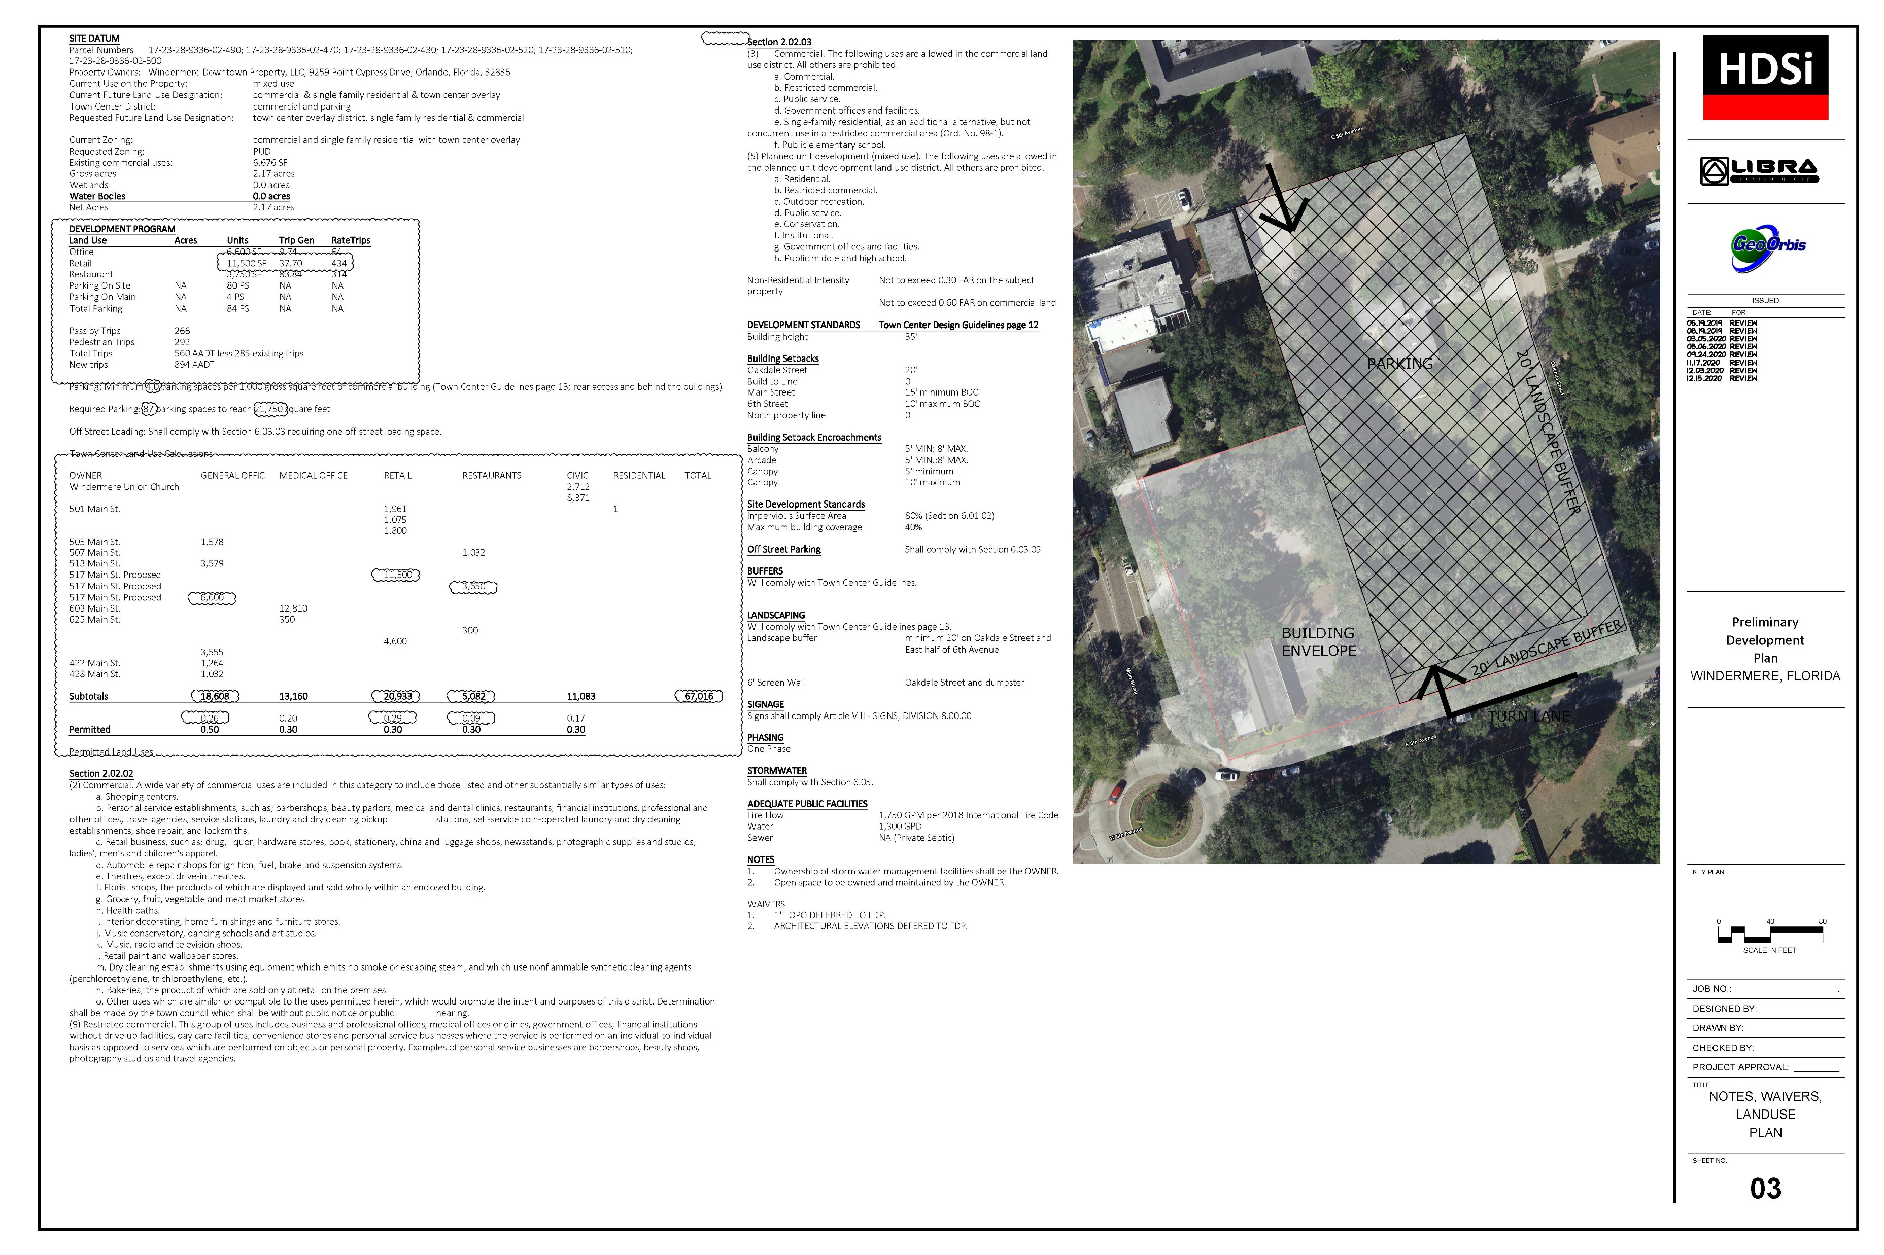

Slide 19
