Slide 2
Forest Street and First Avenue Drainage Study
Purpose
Preliminary evaluation of existing stormwater collection system
Identify potential solutions to carry forward to design
Study Area
Forest Street
Between First Avenue and Second Avenue
First Avenue
Between Forest Street and Butler Street

Slide 3
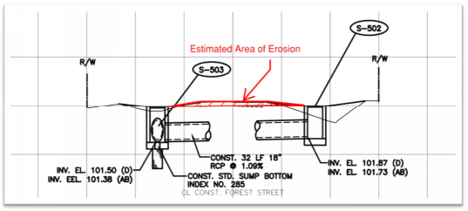
Forest Street and First Avenue Drainage Study
Observations
Video dated July 7, 2019 showed flooding at 110 Forest Street
Inlets were filled with water
Runoff was not entering inlets - Grate tops are higher than dirt road
As-built plans from December 2017 drainage improvements
Shows existing road higher than inlets & roadside swales
Road appears to have eroded in recent years

Slide 4
Forest Street and First Avenue Drainage Study
Observations
Field Visit on September 23, 2019
Inlets and French Drain system with perforated pipe
Standing water in existing inlets about 3’ below grates
Actual groundwater elevation is higher then original design seasonal high groundwater – Back to back wet seasons
Poor exfiltration due to siltation and sediment from road

Slide 5
Forest Street and First Avenue Drainage Study
Drainage Modeling
We modeled the original French Drain system with the following assumptions
Existing pipes only provided 50% capacity
Existing French Drains provided no exfiltration
Simulate 2YR-8HR storm event (3” Rainfall)

Slide 6
Forest Street and First Avenue Drainage Study
Findings
Flooding is likely due to severe clogging of existing pipes
Possible groundwater infiltration in the French Drains
Estimated runoff could be higher due to impervious area added upstream
Existing ground elevation at R/W contains flooding for 2YR-8HR storm event (3” Rainfall)
Further analysis would be required during design

Slide 7
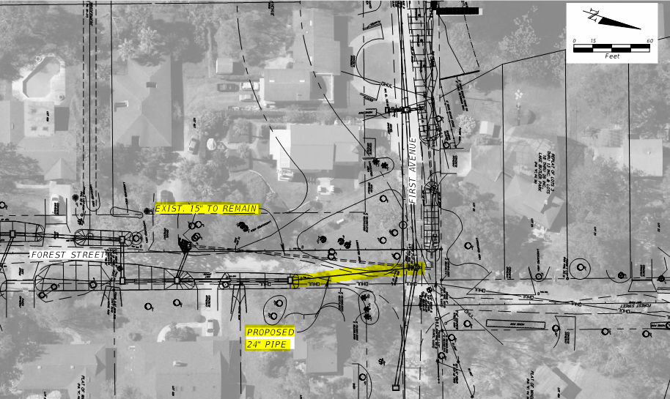
Forest Street and First Avenue Drainage Study
Recommendations
Alternative A -
Keep the Existing Dirt Roads
Upsize the existing 15” outfall pipe to 24”

Slide 8
Forest Street and First Avenue Drainage Study
Recommendations
Improve existing ditches
Add berm to reduce siltation
Add articulated ditch blocks
Add erosion matting to prevent washing out
Add additional ditches at corner of First Ave and Forest Street
Lower inlet elevations or raise elevation of dirt road
Desilt existing system
Create a maintenance plan for road and ditches

Slide 9
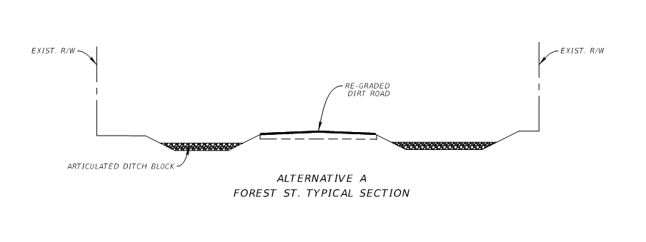
Forest Street and First Avenue Drainage Study
Recommendations
Alternative A - Typical Section

Slide 10
Forest Street and First Avenue Drainage Study
Recommendations
Alternative B -
Pervious Pavement
Construct pervious pavement along First Ave & Forest Street
Add curb and flume system to tie into existing inlets
Upsize the existing 15” outfall pipe to 24”

Slide 11
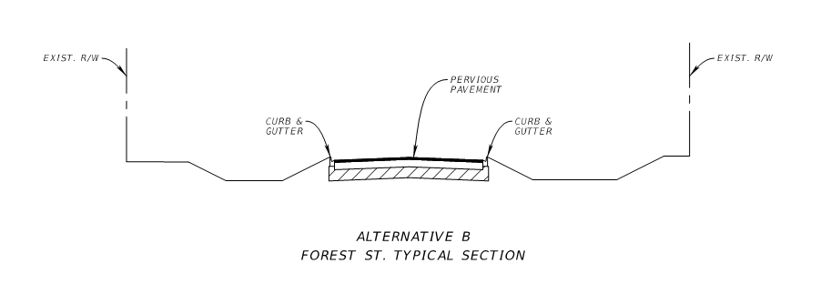
Forest Street and First Avenue Drainage Study
Recommendations
Alternative B - Typical Section

Slide 12
Forest Street and First Avenue Drainage Study
Other Considerations
The backyards of the homes on Forest Street and First Avenue have a history of flooding
Consider adding additional inlet pipe system with a separate outfall
Would require a drainage easement to construct and maintain system

Slide 13
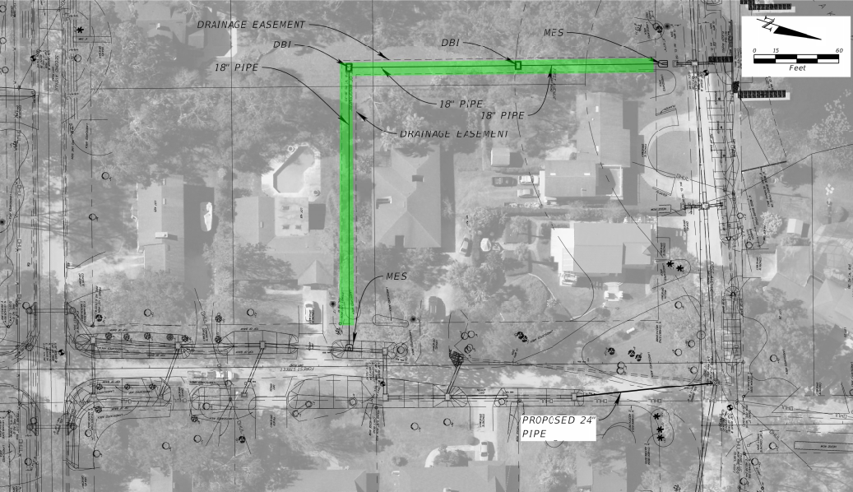
Forest Street and First Avenue Drainage Study
Other Considerations

